Slide 1
Welcome
Thank you for facilitating this book study.
The first few slides will orient you to the general content and overall flow of the book study modules.
  When facilitating the book study, you can hide or remove these slides.
  You’ll notice that a few more slides are hidden throughout the presentation. These slides are guides to support you, the facilitator or co-facilitator, and don’t contain content that is necessary for the participants.

Slide 2
Overview
In this slide deck, we provide some facilitation and speaker notes as suggestions.
The slides and content are pulled from the book, current research, and the process that we completed across three cohorts of teachers.
If you have additional reading content or application questions that you think would be helpful, please add to the slides as needed—make this book study YOURS!
Likewise, if there is content not related to your participants (e.g., What state are you from? if you are all in the same district), feel free to remove it.

Slide 3






Content
Notes:
The content in this book study was developed from information found in Math Pact: Middle School, as well as supporting resources, such as practitioner and journal articles. Much like the evidence-based practices described in the reading, we created the modules so that participants can engage with and have discourse about the content.
The book can be purchased from the publisher: https://us.corwin.com/en-us/nam/the-math-pact-middle-school/book270983

Slide 4
Session Content
Session 1—Chapter 1: Jumping on Board: What Is the Mathematics Whole School Agreement?
Session 2—Chapter 2: Watching What We Say! Using Correct and Consistent Language
Session 3—Chapter 3: Symbol Sense Is Foundational: Noting the Importance of Precise Notation
Session 4—Chapter 4: Mental Images That Last: Cohesive and Consistent Representations
Session 5—Chapter 5: Why Was I Taught That? Evaluating Rules That Expire
Session 6—Chapter 6: Building Generalizations: Developing Instructional Strategies the MWSA Way
Session 7—Chapter 7: Embodying the MWSA in Every Lesson: No Teaching by Telling!
Session 8—Chapter 8: Getting to the Nitty Gritty: Building and Enacting the MWSA and Chapter 9: Sharing Successes From the Field: MWSA Heroes Tell Their Stories!
MWSA: Mathematics Whole School Agreement
Notes:
There are eight sessions; the final session combines the last two chapters.

Slide 5
Session Flow and Content
Introduction: Welcome, Agenda, Outcomes
Warm-Up
Content and Discussion Based on Assigned Reading
Next Steps
Notes:
Each session follows a similar structure and sequence.

Slide 6
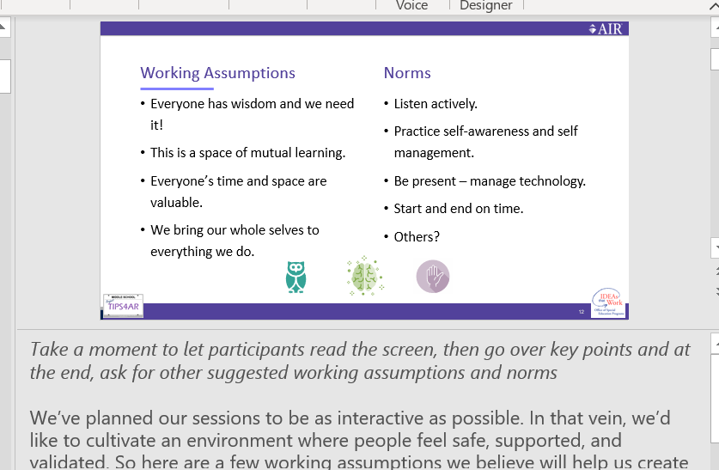
Logistics
Instructions for using the speaker notes
Text formatted in italics are directions or notes for the facilitator; italicized text is not meant to be read aloud.
Text formatted in standard font should be read aloud or paraphrased by the facilitator.

Slide 7
Lessons Learned: Suggestions for Success
When possible, have two facilitators in each session.
  We’ve found a lot of success in having one facilitator play a content implementation role and the other facilitator a support role in which they can attend to logistics and comments in chat.
  These sessions can be facilitated by one person, if needed, but we’ve found that an additional person improves the flow and discourse.
Record the sessions so that participants can revisit material or catch up if they missed a session.
Ensure that there are at least 60 minutes devoted to each session. Consider
90-minute sessions if feasible.
Notes:
Please follow your school guidelines for recording. Share with participants that the sessions will be recorded and only shared with other participants.

Slide 8
Lessons Learned: Suggestions for Success (continued)
We recommend capping the group size at 40 participants. More than 40 participants may impede participant engagement.
Encourage heterogeneity among group participants. Mixed grade levels and a variety of general education and special education roles facilitate deeper discussions.
Use engagement strategies whenever possible throughout sessions (e.g., Jamboard, chart paper). Include real mathematics problems as demonstration items to allow for practice of the evidence-based practice and to increase understanding and participation.

Slide 9
Lessons Learned: Suggestions for Success (continued-2)
Take attendance to monitor participation and ensure that participants are meeting expectations set for incentives, if applicable (e.g., attending X number of sessions earns continuing education hours).
Send out follow-up emails after each session to reiterate expectations and work to be completed by the next session.

Slide 10
Lessons Learned: Suggestions for Success (continued - 3)
Consider hosting course follow-up activities (e.g., open doors, question-and-answer sessions).
Create and maintain a central place (e.g., Google Drive) where course materials (and lessons when conducting the optional lesson study) can be organized and archived for long-term access.

Slide 11
Lesson Learned: Suggestions for Success (continue-4)
Each session includes breakout discussions. Create a variety of groupings so that participants can contribute to and learn from diverse perspectives. Some examples are as follows:
  Groups that align interests and characteristics
    Participant roles (administrator, coach, teacher)
    Instructional grade
    Content or special education expertise
    Level or years of experience
  Spontaneous or random assignment to groups
Notes:
Depending on the overall size of the group, create small groups of two to five participants so that there is ample opportunity for collaboration and discussion.

Slide 12
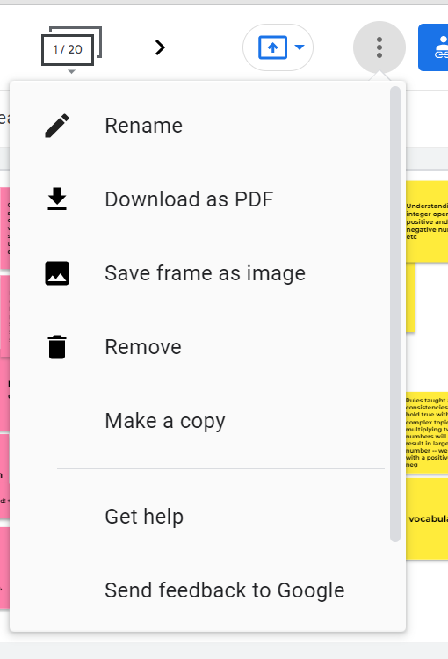
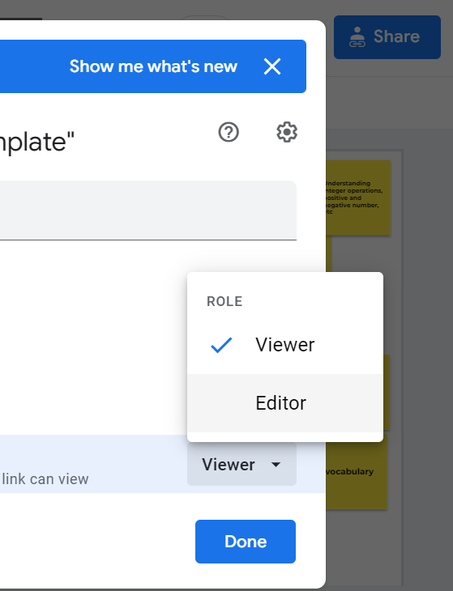
Using Jamboard
Click the three vertical dots
Click share icon
Click make a copy
Change from viewer to editor
Notes:
We have created an online discussion place using Jamboard, but this is just an example. Feel free to utilize various online places typically used by your schools and teachers. Each session includes at least one opportunity for small-group discussion using Google Jamboard. We created a main Jamboard site that facilitators can copy and share in the sessions with participants. The content in the slide deck is tailored to virtual facilitation, but breakout groups can be held in-person and discussions can be documented on boards or chart paper rather than Jamboard if preferred.
Facilitators will need to first visit the Jamboard Template site, make a copy of the slides, and then adjust the settings in the new copy so that participants can edit and contribute on the slides. Once the settings have been adjusted, the new link is ready to share with participants.
Jamboard Template: https://jamboard.google.com/d/18fB8Iy1AT3CtBTkgZXN5hAv5W3kl8sMjGfI9_O8K57c/edit?usp=sharing
New to Jamboard? No problem! Here’s a great tutorial to get yourself acclimated: https://www.youtube.com/watch?v=GbytD_LNVNM

Slide 13

Jamboard
There is a Jamboard icon on each slide that has a corresponding board or activity to complete. The icon also will contain the Jamboard slide number.
Prior to sending participants to the breakout rooms, read the discussion prompt or application questions.
Drop the link for the Jamboard into the chat prior to sending the groups to breakout rooms.
Depending on the overall time of your session (1–2 hours), breakout sessions should be between 5 and 10 minutes.
Notes:
Jamboard icon from https://workspace.google.com/products/jamboard/

Slide 14
Book Study
Session 1: Introduction and Overview of Chapter 1: Jumping on Board: What is the Mathematics Whole School Agreement?
Notes:
This module is the first in a series of modules focused on content in The Math Pact, Middle School: Achieving Instructional Coherence Within and Across Grades and some supporting materials.
The purpose of this study is to focus on the facilitation of student discussions, teacher discourse, and overall discourse in middle school mathematics classes. Student discourse leads to greater student engagement and conceptual understanding but often is limited in middle school mathematics classrooms. In addition, many students who struggle or students with disabilities often lack the prerequisite skills, vocabulary, and working memory to actively engage. The limited engagement can further widen the academic gap. Each module is designed to be completed during a 1-to-2-hour group session. This book was selected as it bridges evidence-based practices (EBPs) with practical strategies for teachers to implement. It pairs nicely with college and career readiness standards, as well as instructional/practice standards across the United States.
Welcome participants to the book study. Introduce yourself (or yourselves) as the facilitator(s) and briefly cite your professional experience in mathematics instruction and supporting students who struggle and students with disabilities in mathematics.

Slide 15
Agenda
Introductions
Housekeeping
Book Study Overview
Characteristics of Students Who Are Struggling With Mathematics and Students With Disabilities in Mathematics
Next Steps
Notes:
[Read slide.]

Slide 16
Objectives
Discuss the purpose and goals of our book study.
Identify common characteristics of students who struggle with mathematics and students with disabilities.
Describe evidence-based practices and how these practices support student learning.
Define classroom discourse and discuss the impact this has on student algebraic learning and outcomes.
Notes:
Read through slide content; pause and ask participants if they have any questions.
Today, the content is focused on Chapter 1: “Jumping on Board: What Is the Mathematics Whole School Agreement?”

Slide 17
Introductions

Slide 18

Introductions
Facilitator introductions
Your turn!
  Please give your name, state, grade, and role.
  What is one word that describes your teaching, future goals, love of mathematics, or what you want to take into this school year?
Notes:
Although you have already introduced yourself, please take a moment to state your name again and briefly describe your interest in mathematics or your hope for this book study. Once the facilitator(s) have introduced themselves, prompt participants to introduce themselves using the information on the slide as a guide for their brief introduction.

Slide 19
Housekeeping

Slide 20

Working Assumptions
Norms
Everyone has wisdom that we need!
This is a space of mutual learning.
Everyone’s time and space are valuable.
We bring our whole selves to everything we do.
Listen actively.
Practice self-awareness and self-management.
Be present; manage technology.
Start and end on time.
Others?
Notes:
Take a moment to let participants read the screen; then review the key points. At the end, ask for other suggested working assumptions and norms.
We’ve planned our sessions to be as interactive as possible. In that vein, we would like to cultivate an environment in which people feel safe, supported, and validated. So here are a few working assumptions we believe will help us create and maintain a safe space for learning and engagement.
Everyone has wisdom that we need.
This is a space of mutual learning.
Everyone’s time and space are valuable.
We bring our whole selves to everything we do.
To actualize these assumptions, let’s all agree to listen actively. To actively question and share thoughts. To practice self-awareness and self-management. We want to assure that everyone's voice is heard so that all feel as if they can engage. To be present, please manage technology and distractions. We’ll do our best to keep to our time. Validate others when they speak. Are there any other norms that you’d like to add, especially because we are in a virtual space?

Slide 21
Using a Virtual Platform
Use the black bar on your screen to control your audio and video and to view the participant list and chat.
  When you join, your audio will be muted. Please remain muted when you’re not speaking.
  We welcome you to turn on your camera and join us via video.
Use the Raise Hand button on your participant feedback bar to volunteer to speak; the presenter will call on you.
Use the chat to message for tech support.
Notes:
Use this slide if you hold the meeting virtually. This guide is tailored to Zoom, so some adjustments may be necessary if using another platform.
You have the ability to mute and unmute yourselves.
If you haven’t already, we encourage you to share your camera and join us via video.
Keep the chat box and participant panel open because we’ll be using them both throughout our sessions.
If you have a question about the platform, feel free to toss your question in the chat box, and we’ll help you out.

Slide 22
Book Study Overview

Slide 23


Goal
Increase classroom discourse, conceptual understanding, and algebraic reasoning for students in middle school through evidence-based practices.
The Math Pact, Middle School: Achieving Instructional Coherence Within and Across Grades (Authors: Sarah Bush, Karen Karp, & Barbara Dougherty; 2020; Corwin Press)
Notes:
Here you will provide the purpose of the book study and supporting content and activities. The goal is to provide an overview of the concepts and enhance participant background knowledge and understanding.
Our goal in this book study is to impact student outcomes; specifically, we want to increase classroom discourse, conceptual understanding, and algebraic reasoning for students in middle school through evidence-based practices. We will approach these goals by supporting you as you navigate this book and the supporting resources, and we, as a group, have our own whole and small-group mathematics-focused discourse.

Slide 24
How Will We Achieve This Goal?
Increase your understanding of instructional practices to increase student engagement.
Increase the use of higher-level questions during teaching and in assignments (in-class and homework).
Increase the use of multiple representations.
Increase your use and ability to use learning tools within instruction.
Notes:
[Read slide.]

Slide 25
Activities
Book Chapters
Supplemental Readings
Group Sessions
Deepen Understanding
Notes:
To deepen your understanding of the content presented in the book, we will have three main activity areas throughout the study. You will read a chapter between each session from The Math Pact. We will occasionally have supplemental readings from research or practitioner articles to extend or provide additional examples of the instructional practice. We will hold sessions, such as this one, during which we discuss concepts from the readings not only as a whole group but in breakout small-group sessions as well.

Slide 26
Characteristics of Students Who Are Struggling With Mathematics and Students With Mathematics Disabilities
Notes:
[Read slide.]

Slide 27


Discussion
Slide 1
Consider all your students (above, on level, below). To what extent are the students receiving the same mathematical experiences? (pink)
Why do students struggle in mathematics? What specific skills do you see as the most challenging? (yellow)
What misconceptions do you see students demonstrating in class? Why is it happening? (blue)
Notes:
Here is a link to the Jamboard Template; make sure to update the notes with the Jamboard link for this specific book study prior to the session: https://jamboard.google.com/d/18fB8Iy1AT3CtBTkgZXN5hAv5W3kl8sMjGfI9_O8K57c/edit?usp=sharing
Create groups for the breakouts.
Read the discussion questions, place the Jamboard link into chat, and then send participants into their breakout rooms.

Slide 28
Common Challenges in Understanding Mathematics for Students with Mathematics Difficulties
Working memory
Number sense
Symbols
Whole number computation
Word problem solving
Vocabulary
Self-regulation
Notes:
[Read slide.]
These are the common deficits in students with difficulties in mathematics. During today’s session and future sessions, we will develop a better understanding of these deficits and how we can be proactive in planning and addressing these areas, while using student strengths.

Slide 29

What is Working Memory?
“. . . a limited capacity central executive system that interacts with a set of two passive store systems used for temporary storage of different classes of information” (Baddeley & Logie, 1999, p. 34).​
Implications for mathematical operations include the following:​
  Number computations​
  Effective strategy use​
  Word problems​
  Multistep problems
  Retrieval or fluency
Notes:
Working memory affects number computations, specifically strategy use. Often, students will use inefficient strategies, such as counting all, and do not remember or use the strategies correctly. When the student takes so much time and “clogs” the working memory, solving problems, especially multistep problems, can provide greater challenges. Working memory affects word-problem solving and multistep problem solving because the student must store so much information and can tire easily, thus forgetting to do additional steps or check the reasonableness of their answers.
Think of reading and fluency. When a student takes a long time to read, they get tired, and comprehension lowers. This also is true of mathematics and working memory.

Slide 30
What is Number Sense?
Flexibility with numbers​; ability to make sense of what numbers mean and the ability to manipulate or “see” patterns in numbers
Skills include the following:
  Counting
  Decomposing
  Magnitude comparisons
  Links to advanced computational strategies
  Precursor to fractions
Notes:
Students with a strong number sense in early elementary school are more successful in later grades. A more developed number sense leads to flexibility of number decomposition (Siegler, 1988) and an understanding of counting principles, such as cardinality, order, and abstraction (Geary, 2004). The mastery of number sense, flexibility in counting, and decomposing is essential for long-term conceptual understanding.

Slide 31
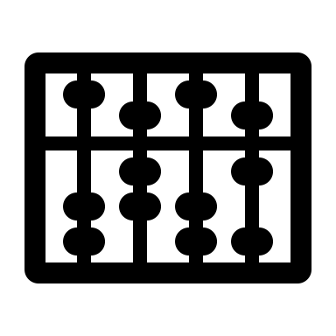



What are Symbols?
Slide 2
On Jamboard, brainstorm all the symbols students see across grades 6–8.
Notes:
[Give participants 3 minutes to brainstorm all the symbols that middle school students encounter.]
Before we talk about symbols, we will first brainstorm all the symbols that students encounter in middle school.

Slide 32
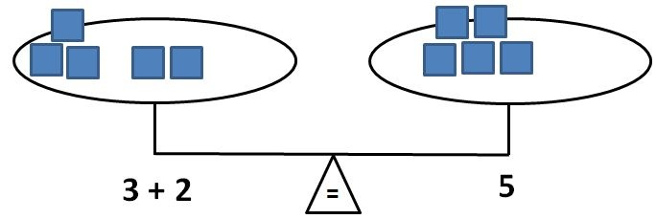
Importance of Teaching Symbols
Symbols are an integral part of mathematical language.
Students need to develop an understanding of the symbolic equivalence between numbers and symbols.
Explicitly teach operational symbols, such as the following:
  Equals sign
  Addition and subtraction
  Multiplication and division
  Fraction bars
Notes:
It is important to explicitly teach symbolic representations. Too often, these representations are not directly or explicitly taught. For example, for many students, the equals sign means “answer” rather than “the same as.” A lack of a full understanding of the equals sign affects number sense and computational understanding. In the future, this lack of understanding can affect understanding of equations and can lead to challenges when students are trying to balance equations.

Slide 33
What are Whole-Number Computations?
Whole-number computations represent an efficient and accurate method for solving operational problems to mastery.
Includes both basic facts (addition, subtraction, multiplication, and division) and the ability to apply these skills to multistep computations.
Need explicit instruction in strategies to
  understand the relationships between numbers and
  gain conceptual understanding of how to solve efficiently and with fluency.
Notes:
Whole-number computation is important and a key foundational skill for students exiting elementary school and should be part of instruction starting as early as kindergarten. For students receiving intervention support, whole-number computation can be challenging and may be impacted by working memory, as well as by a student’s understanding of how numbers relate to one another, such as the concept of part-part-whole within fact families, how numbers are related, or how to use strategies efficiently. Often, students with mathematical difficulties have delays in both process or conceptual understanding, as well as procedural fluency, which may result in inefficient or incorrect strategy use, thus leading to greater confusion.
What does mastery of facts mean? Ideally, by the end of Grade 5, if students were given an addition, subtraction, multiplication, and division sheet with 100 questions, they should correctly solve at least 80% of the problems on all sheets within 1 minute for each sheet.
How does whole-number computational skills affect student understanding in your class?

Slide 34
What is Word Problem Solving?
Mix of numbers and words in which students apply mathematical skills
Challenges in solving word problems:
  Vocabulary
  Language
  Multiple steps
  Selecting correct algorithms
Notes:
Word problems often are the way students are tested to measure their understanding of computational skills, yet they often are challenged as a result of reading skills, mathematical vocabulary, working memory, and basic number sense. The other challenge with word problems is that students often are not taught efficient strategies for solving them. For example, many students rely on key words, an instructional practice that leads to an inability to understand the problem and often leads to an incorrect answer. Students need greater instruction and practice in identifying the schema or problem type with ways to solve that are efficient and can be applied to all word problem types.

Slide 35
What are Key Mathematics Vocabulary?
Polysemous words, words that have different meanings, can cause confusion for students, especially when comparing typical use of the words in English versus mathematics. Examples of these words are as follows:
  Difference
  Factor
  Product
Vocabulary terms often are not explicitly taught as part of core instruction.
Interventions do not always stress the use of mathematical precise language by students and/or teachers.
Notes:
[Read slide.]

Slide 36
Vocabulary Can Be Confusing!
Consider the role of language in the following sentence:
  The teacher said the student is mean.
  The teacher, said the student, is mean.
Think about these simple sentences and how they can lead to confusion for students. When we talk about pairs, are we talking about one or two items?
  Pair of shoes.
  Pair of socks.
  Pair of pants.
Notes:
[Read slide.] Think about the word “pair.” How many shoes do I have if I have a pair? (2) What about a pair of socks? (2) When you have a pair of pants, how many pants do you have? (1) Why is vocabulary or grammar so important?

Slide 37
Vocabulary Within Instruction
Teachers often use vocabulary that has multiple meanings in English.
  Give your little brother the “bigger half” of the cookie.
  “Carry” the one.
  “Borrow” the ten.
  “Cancel” when simplifying a fraction or rational expression.
  Write or create an improper fraction (Is there a proper fraction?)
Consider this example: “Add these numbers up.”
12
6
+ 7
Notes:
Mathematics vocabulary is challenging. Teachers either do not explicitly teach vocabulary, assume that the student already understands the words, or do not practice using precise language, leading to confusion or lack of understanding. Consider these examples. [Read slide.]

Slide 38
What is Self-Regulation?
Self-regulation is the attitude and abilities required to act as the “primary causal agent in one’s life and to make choices regarding one’s actions free from undue external influence or interference” (Wehmeyer, 1992, p. 305).
Self-regulation includes the following three components:
  Autonomy
  Relatedness
  Competence
Lack of self-regulation may lead to decreased academic achievement.
Self-regulation should be embedded within interventions and core instruction.
Notes:
[Read slide.]
Self-regulation is essential for all students but tends to be a weakness for students with mathematics difficulty. To increase self-regulation, we need to empower students to feel more autonomy, a sense of understanding or relatedness to the material—seeing that mathematics is important—and competence or confidence in being successful with difficult work. When teachers support students, they explicitly teach strategies that lead to deeper understanding, and students tend to increase self-regulation and often are more engaged in their own learning!

Slide 39
Endless Cycle for Students Who Struggle
Low Self-Regulation
Mathematics Difficulty
Low Motivation
Attention Issues
Notes:
When we think about self-regulation, we often think about it paired with motivation. For students in middle school, they have been stuck in this cycle for many years and often feel as if they cannot ever improve, Thus, teachers are challenged with kids who say they hate mathematics or that they are not good at it because of this cycle.

Slide 40

Supports for Students Who Struggle
Understanding student characteristics
Increasing student conceptual
understanding
Planning high-quality
tasks
with
scaffolds
Increase mathematics achievement, confidence & competence
Notes:
We can break the cycle for students by using strong instructional practices and scaffolds to increase student understanding and, in turn, increase mathematics achievement. We’ll talk a little more about practices that can support students who struggle or have difficulties in mathematics in just a moment.

Slide 41
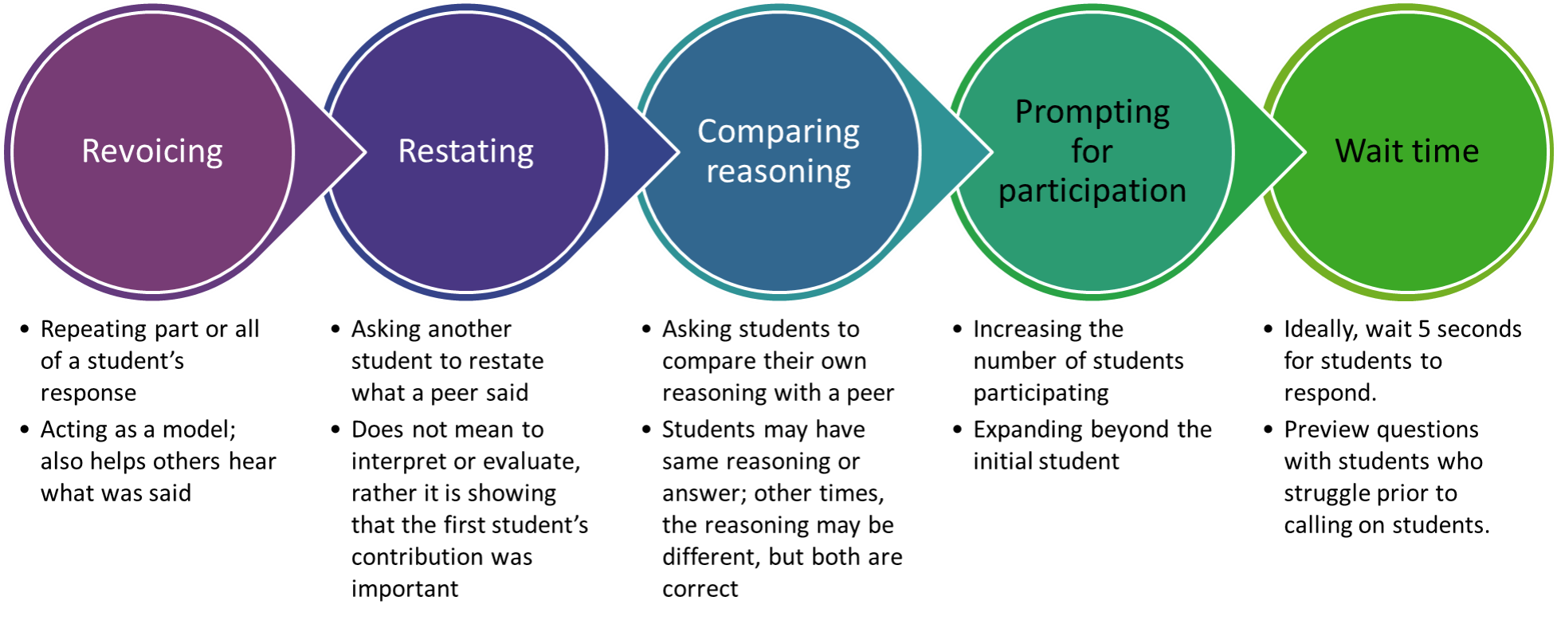
Intersection of HLPs and EBPs
Increased student conceptual understanding
Evidence- based practices (EBPs)
High-leverage practices (HLPs)
Notes:
When used together, evidence-based practices (EBPs) and high-leverage practices (HLPs) can become powerful tools for improving student outcomes.
EBPs for special education are instructional strategies backed by research and professional expertise to support the learning and behavior of students with disabilities. They often are content focused and appropriate for students at different developmental levels.
HLPs focus directly on instructional practice and can be used to teach or as a pair alongside EBPs.
Additional resource you can share in chat: For more information about HLPs and EBPs, check out the video “Clarifying the Relationship Between HLPs and EBPs” (https://highleveragepractices.org/clarifying-relationship-between-hlps-and-ebps).

Slide 42
Complete
Slide 3
Complete the following problem:
  Kara is buying party invitations. The party store sells a $10 box that contains 24 cards or a $25 box that contains 60 cards.
  Which is the better deal? Why?
Create another card box that would be equivalent to the better deal.
Now that you have solved the problem, show a different way to solve.
Notes:
Facilitators can have participants work individually on the Jamboard and then discuss the responses as a whole group or create groups for the breakouts.
Read the discussion questions and give participants a moment to respond or place the Jamboard link into chat, send participants into their breakout rooms, and then discuss as a whole group after everyone returns.

Slide 43
Anticipating
First, what was the task?
Second, anticipate student responses. What are all the possible responses? How might students solve?
What would make this problem challenging for students who have difficulties with mathematics?
Notes:
When instructing students, especially students with difficulties in mathematics, it is important to anticipate hurdles or challenges they may have prior to instruction. Let’s think about that last problem.
[Read slide and have participants respond.]

Slide 44
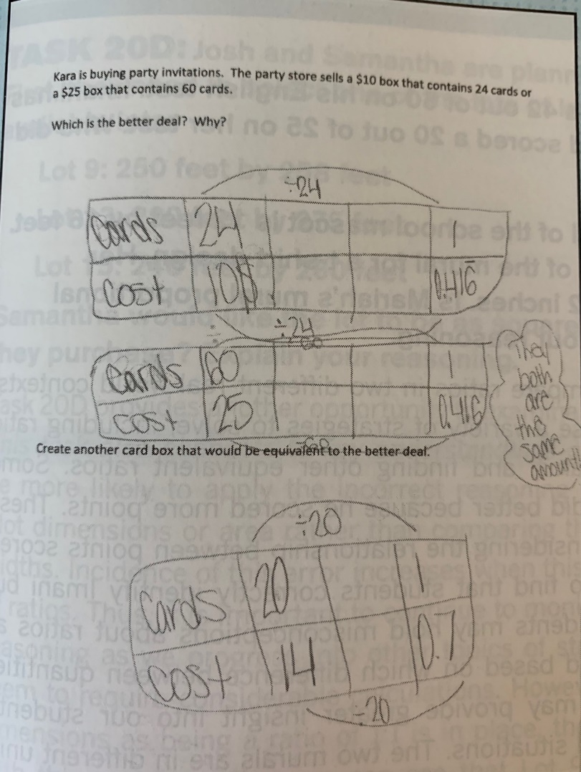
What Did They Do?
Does the student understand how to use rates to compare? How do you know?
How did she solve?
What type(s) of error did she make?
What additional instruction/support will she need? Why?
Source: SanGiovanni & Novak (2018).
Notes:
Look at the student's response on the right. It says that Kara is buying party invitations. The party store sells a $10 box that contains 24 cards or a $25 box that contains 60 cards. Which is the better deal? Why? First, this student created two tables to show the cards that are $10 for 24 cards and then a table that shows 60 cards for $25. The student then showed divided by 24 to show that each package is 1 card for $0.416 and wrote they both are the same amount.
Then the student had to create another card box that would be equivalent to the better deal. Again, they made a table to show 20 cards at a cost of $14 and then divided the top and bottom by 20.
[Give participants a moment to review the student’s work and then prompt a discussion with the questions on the left.]

Slide 45
Next Steps

Slide 46
Homework
Read Chapter 2, “Watching What We Say! Using Correct and Consistent Language”
  Think about how you currently teach and reflect on what you are doing great or needing to change
  Write down any questions or “aha!” moments that arise while reading.
While reading, consider the following:
  Why is consistent mathematical language essential during instruction?
  How should you introduce vocabulary in mathematics lessons?
  How does vocabulary instruction differ in mathematics compared with other content areas?
  How does mathematics discourse differ from conversational language?
Plan for our next session: DATE
Notes:
Add the date for the next session and any other pertinent information. Read the slide and highlight important information.

Slide 47

Questions?
Please reach out if any additional questions or conflicts arise.
We look forward to our next session.
Notes:
Add facilitator name and contact information on the slide.

Slide 48
Book Study
Session 2: Evidence-Based Practices and Chapter 2: Watching What We Say! Using Correct and Consistent Language

Slide 49
Agenda
Warm-Up
Evidence-Based Practices in Mathematics
Vocabulary
Next Steps
Notes:
[Read slide.]

Slide 50
Objectives
Describe how student discourse can impact conceptual and algebraic understanding for middle school students.
List several HLPs and EBPs that support student discourse.
Establish the value of using technical mathematical terminology and vocabulary when teaching all students, including students who struggle with mathematical concepts.
Identify how students’ language abilities affect their success in mathematics.
Notes:
Today we will discuss the content in Chapter 2: “Watching What We Say! Using Correct and Consistent Language.” By the end of the session, you should be able to [read slide.]

Slide 51
Warm-Up
Notes:
Before we jump into the content, let’s get our mathematical brain ready to go. As we complete the next problem, think about the way you might solve it as well as how your students may solve it.

Slide 52
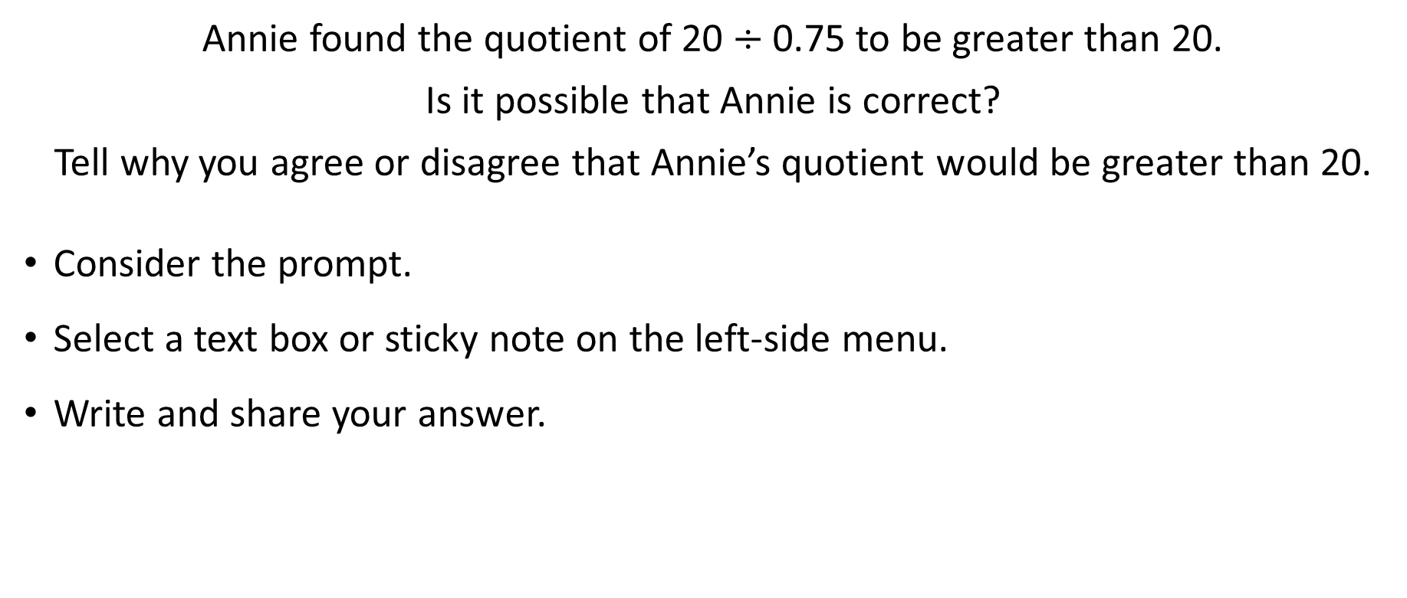
Solve
Slide 4
Annie found the quotient of 20 $÷$ 0.75 to be greater than 20.
Is it possible that Annie is correct?
Tell why you agree or disagree that Annie’s quotient would be greater than 20.
Consider the prompt.
Select a text box or sticky note on the left-side menu.
Write and share your answer.
Notes:
Here is a link to the Jamboard Template; make sure to update the notes with the Jamboard link for this specific book study prior to the session: https://jamboard.google.com/d/18fB8Iy1AT3CtBTkgZXN5hAv5W3kl8sMjGfI9_O8K57c/edit?usp=sharing
Read the discussion questions and give participants a moment to respond or place the Jamboard link into the chat.

Slide 53
High-Leverage & Evidence-Based& Practices in Mathematics

Slide 54
High-Leverage Practices in Special Education
Collaboration
Collaborate with professionals to increase student success.
Collaborate with families to support student learning.
Assessment
Use multiple sources of information to develop understanding of student’s strengths and needs.
Communicate assessment information with stakeholders.
Use data to improve instruction and improve student outcomes.
Generalization
Provide positive and constructive feedback to guide students’ learning and behavior.
Teach students to maintain and generalize new learning across time and settings.
Source: https://highleveragepractices.org/
Notes:
HLPs are instructional strategies that can promote student understanding across subject areas. These three specific HLP areas can support EBP implementation and student success in mathematics.

Slide 55
Mathematics Evidence-Based Practices
What Is Discourse?
Notes:
There is a strong evidence base for discourse, but what is discourse?
Pause and then have participants share out or put responses in the chat.

Slide 56
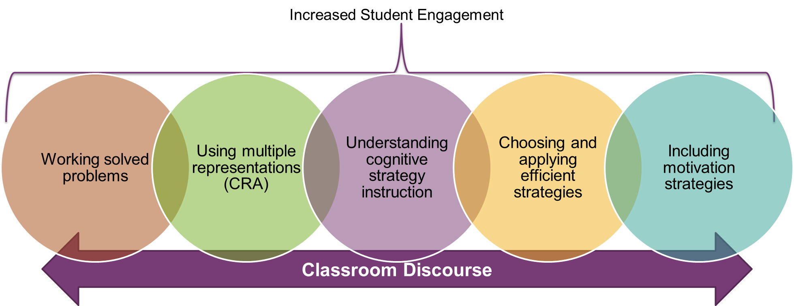
Mathematics Evidence-Based Practices
CRA = concrete-representational-abstract
(Adapted from Fuchs et al., 2021; Star et al., 2019)
Notes:
For discourse to be evident in the classroom, we need to create a learning environment in which students feel and see success. For students with mathematics difficulties, this means that teachers need to be intentional and purposeful in using EBPs, such as working solved problems, using multiple representations often referred to as concrete-representational-abstract, explicitly teaching effective strategies and cognitive strategy instruction, and using motivation strategies that can lead to increased self-regulation.
When students are successful and develop conceptual understanding, they are more likely to be engaged and have the skills to actively participate in classroom discussions. When this happens, a teacher is truly increasing classroom discourse.

Slide 57
Vocabulary
Encouraging Math Precise Language During Classrooms Discussions

Slide 58

Vocabulary Words
Slide 5
Words are important!
Any aha moments from the reading?
Precise mathematical vocabulary is challenging for students, teachers, and families.
In 2 minutes, write down as many mathematics words that you can that your students may be exposed to during the school year.
  Symbols
  Steps
Notes:
Jamboard (slide 5)
Here is a link to the Jamboard Template; make sure to update the notes with Jamboard link for this specific book study prior to the session:
https://jamboard.google.com/d/18fB8Iy1AT3CtBTkgZXN5hAv5W3kl8sMjGfI9_O8K57c/edit?usp=sharing
Read the discussion questions and give participants a moment to respond or place the Jamboard link into the chat. Participants can have a few minutes to respond and then highlight key points and share out as a group.

Slide 59
The Problem With Mathematics Is English
The language and symbolism of mathematics greatly influences the math itself, including the following:
  The content taught within and across grades
  The way we choose to communicate that content
Incorrect or lack of explicit instruction often leads to misconceptions, such as the following:
  High school students in higher level mathematics classes who incorrectly define an equation as “when you solve for x.”
  Students starting middle school thinking that subtraction always starts with the “bigger” number.
How does this misconception form? How does it affect success in mathematics?
Source: Molina (2012)
Notes:
[Read slide.]
Mathematics isn’t just numbers and symbols; language is an essential part of mathematics as well. How does language impact mathematical success?

Slide 60
Convergence of Mathematics and English
Abstract terms: Words often represent concepts rather than objects, such as the following:
  Quotient
  Sum
  Factor
Polysemous terms: Words that have more than one meaning or definition, such as the following:
  Factors
  Product
  Volume
Notes:
[Read slide].
Language can impact success for all students, especially students with disabilities, multilingual students, and students at risk.

Slide 61
Convergence of Mathematics and English
Homonyms and similar spellings: Words with similar pronunciations or spellings, or words that sound alike but have different meanings, such as the following:
  Sum of the numbers if you rearrange some of them
  Algorithm
  Logarithm
  Paradigm
Ambiguity: Words with lexical ambiguity and idiomatic meaning, such as the following:
  Pair
  Add it up
  Reduce
Notes:
[Read slide.]

Slide 62
Example
The opening number was the highlight of the show.
His last girlfriend really did a number on him.
My finger is number than it was 5 minutes ago.
Notes:
Here are some examples of the convergence of mathematics and language. Consider the word “number.” This word has multiple meanings and can be difficult to understand for students with mathematics difficulty and multilingual students.

Slide 63

Introducing Vocabulary: Let’s Chat
How do you introduce and teach vocabulary?
Do you use mnemonics? Which ones? Put them in chat!
Do you think it is effective? Why or why not?
How do you encourage precise mathematics language?
Notes:
[Read slide. Put participants into breakout groups to discuss.]

Slide 64

Vocabulary During Instruction
Slide 6
Consider all the words that we brainstormed.
Consider lessons learned from the chapter and our discussion.
Head over to Jamboard.
  What words did you formerly use?
  What words do you agree to use instead?
Notes:
Here is a link to the Jamboard Template; make sure to update the notes with Jamboard link for this specific book study prior to the session:
https://jamboard.google.com/d/18fB8Iy1AT3CtBTkgZXN5hAv5W3kl8sMjGfI9_O8K57c/edit?usp=sharing

Slide 65
Next Steps

Slide 66
Homework
Student Poll: Ask your students (via exit ticket, assignment) one of the following:
  What does the equals sign mean?
  Provide a definition of the equals sign
Be prepared to share student responses in the next session.

Slide 67
Homework
Complete the assigned readings:
  “Creating Optimal Opportunities to Learn Mathematics”
  Chapter 3: “Symbol Sense Is Foundational: Noting the Importance of Precise Notation”
While reading, consider the following:
  How do you explicitly teach symbols or notations?
  Why are symbols and mathematical notations so challenging for students? How does it impact their success and understanding?
Plan for our next session: DATE
Notes:
Share article with participants or insert into a shared folder.
Add date to next meeting.
Read slide.

Slide 68
Book Study
Session 3: Article and Chapter 3: Symbol Sense if Foundational: Noting the Importance of Precise Notation

Slide 69
Agenda
Warm-Up
Poll Results Discussion
Article Discussion
Chapter 3
Next Steps
Notes:
[Read slide.]

Slide 70
Objectives
Describe common challenges in meeting the needs of students would struggle in mathematics.
Identify ways to collaborate across grade levels and between core and special education that assure student success in mathematics.
List common notations and symbols used in secondary mathematics courses.
Notes:
Today we will focus on Chapter 3. Our objectives are as follows: [Read slide.]

Slide 71
Warm-Up

Slide 72

Solve
Slide 7
Yearly memberships at Gym A and Gym B each consist of an annual fee plus a constant monthly fee.
The annual fee at Gym A is greater than the annual fee at Gym B. Both gyms have the same yearly membership costs. What is the relationship between the monthly fee for Gym A and then monthly fee for Gym B?
Head over to Jamboard, slide 7. Select the text box and write your answer.
Notes:
Math question from the National Assessment of Educational Progress (NAEP): Grade: 8; Year: 2017; Content Classifications: Algebra, High; Type: SCR; Difficulty Level: Hard
Here is a link to the Jamboard Template; make sure to update the notes with Jamboard link for this specific book study prior to the session:
https://jamboard.google.com/d/18fB8Iy1AT3CtBTkgZXN5hAv5W3kl8sMjGfI9_O8K57c/edit?usp=sharing
Read the discussion questions and give participants a moment to respond or place the Jamboard link into the chat.

Slide 73

Think About It
What are the key vocabulary needed to solve? What notation(s) are needed to solve?
What is the task asking us to do? What skills is it measuring?
What misconceptions does it address? How could you address or respond to misconceptions?
Why is this skill challenging for students?
Notes:
[Facilitate discussion once participants share from their Jamboard responses; use the prompts here for further discussion and discourse.]

Slide 74
Poll Results

Slide 75

Poll Results
What responses did you receive when you asked your students, “What does the equals sign mean?” or “Provide a definition of the equals sign.”
Notes:
[Read slide and facilitate discussion.] Were there any surprises?

Slide 76
Article Discussion
“Providing Support to Students Who Are Struggling”
Notes:
See resource list for link to article.

Slide 77

Co-teaching Discussion
What are the challenges to increasing the number of co-taught classrooms?
What model(s) do you see in most co-taught mathematics classes?
How do you promote collaboration at your school?
  Across grade levels
  Between core and special education?
How do you share ideas across grade levels?
Notes:
After reading the article, consider your experience in coteaching or just collaborating with other professionals in general.
Read questions and have participants respond.

Slide 78
Chapter 3 Discussion

Slide 79
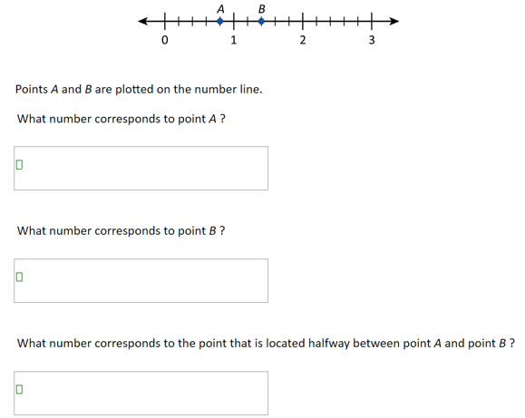
Let’s Try Some Math
Slide 8
Source: National Assessment of Educational Progress sample question 2017, Grade 8.
Notes:
Let’s attempt a sample question from the NAEP, Grade 8.
Send participants to breakout rooms.
Here is a link to the Jamboard Template; make sure to update the notes with Jamboard link for this specific book study prior to the session:
https://jamboard.google.com/d/18fB8Iy1AT3CtBTkgZXN5hAv5W3kl8sMjGfI9_O8K57c/edit?usp=sharing
Read the questions and give participants a moment to think and then place the Jamboard link into the chat

Slide 80
Let’s Discuss
What skill(s) are being tested as part of this question?
What are the prerequisite skills needed to solve?
What notation?
What grade level do you assume this would be an appropriate task?
Scoring:
  Correct: All three parts correct
  Partial: Two parts or one part correct OR Part C is correct based on incorrect answers in Part A and/or Part B
  Incorrect
Notes:
That question was for eighth graders, even though it may seem a bit easy. This item was scored as correct, partial, and incorrect. Think about your own students and their understanding of a number line.
How many eighth graders answered correctly? (only 27% of eighth graders answered correctly)
How many eighth graders received a partial score? (25% answered partially)
How many eighth graders answered incorrectly? (45% answered incorrectly, with 3% skipping the question)

Slide 81
Precise Notation
Symbols are
  an essential part of mathematical understanding,
  a communication tool, and
  universal around the world.
Symbols often can be categorized into five major categories:
  Operations/computations
  Relation
  Grouping
  Sets
  Miscellaneous
Notes:
[Read slide.]

Slide 82
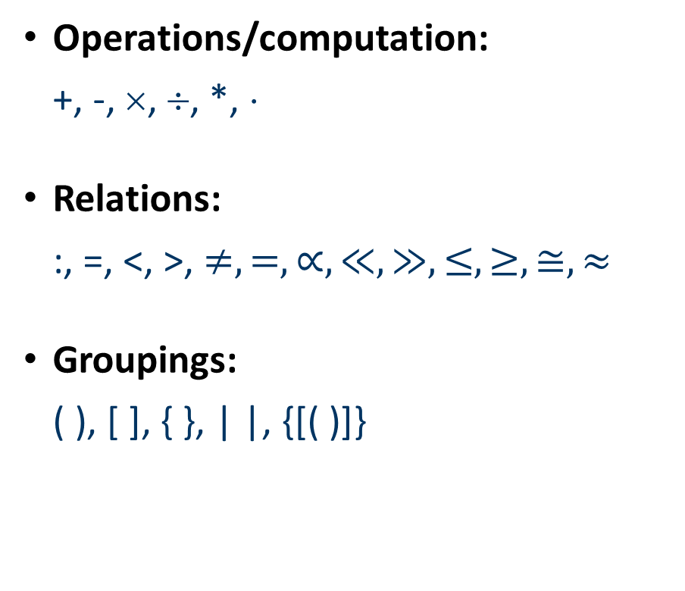

Symbols
Operations/computation:
+, -, ×, ÷, *, ⋅
Relations:
:, =, <, >, $≠, =, ∝, ≪, ≫, ≤, ≥, ≅, ≈$
Groupings:
( ), [ ], { }, | |, {[( )]}
Sets:
$∅, ∈,${ }
Miscellaneous:
$\sqrt{}, \%, °, ∞, ⋯$
Notes:
Here are some examples of symbols used in mathematics. As you look over these, consider how these symbols might pose difficulty to some students. In thinking about creating your own worksheets, handouts, or a PowerPoint, for example, do you know where to find the correct notation in Microsoft for these symbols?

Slide 83
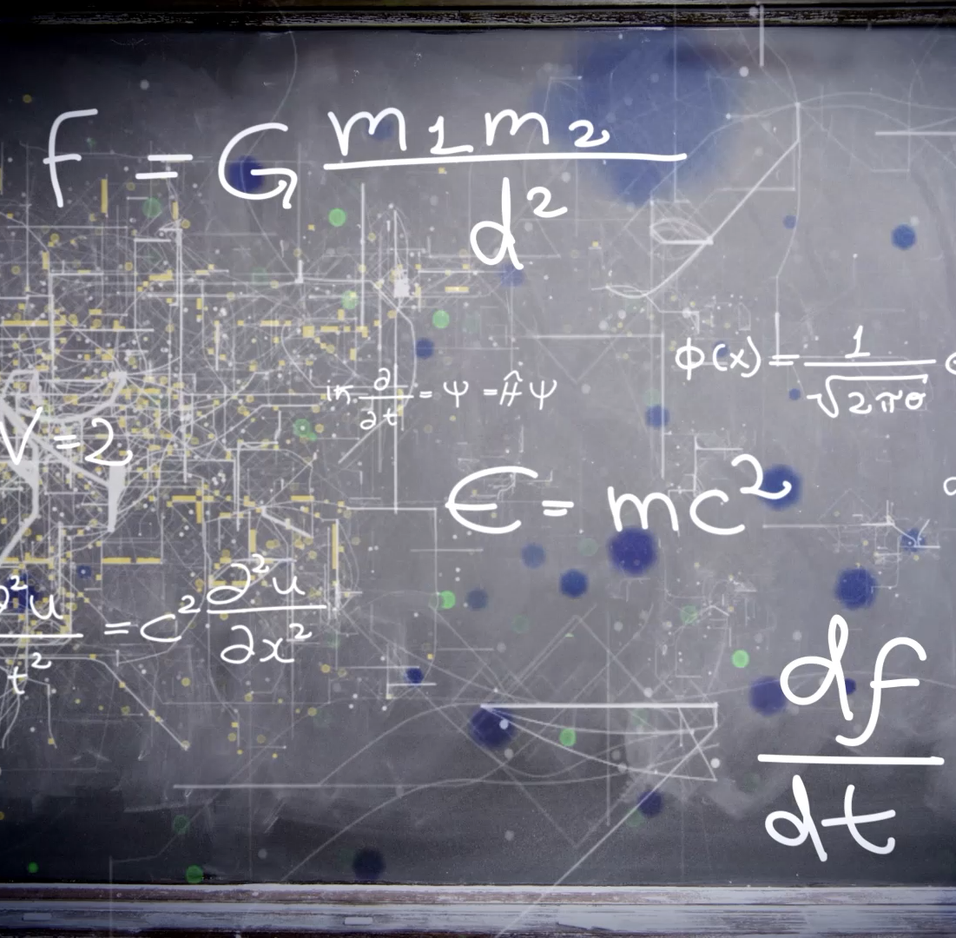
Commonly Used Notation
As you read the chapter, any surprises?
What notations do you use that you want to “purge”?
What notations do you see as the most challenging for students? What notations or symbols are the most confusing for students?
Notes:
Ask participants to consider their reactions to the readings; then prompt a discussion by reading these questions.

Slide 84
Next Steps

Slide 85
Homework
Complete the assigned reading: Chapter 4: Mental Images That Last
While reading, consider the following:
  What are representations and what are categories of representations?
  What challenges should we consider when planning instruction on representation?
  How do students benefit from the use of representations?
Plan for our next session: DATE
Notes:
Add date and time for next session. [Read slide.]

Slide 86
Book Study
Session 4: Chapter 4: Mental Images That Last: Cohesive and Consistent Representations

Slide 87
Agenda
Warm-Up
Representations
Use of Representations to Communicate Thinking
Next Steps
Notes:
[Read slide.]

Slide 88
Objectives
Describe the impact of using representations to communicate mathematical thinking.
Differentiate multiple representations and identify the impact of using multiple forms.
Identify how representations increase student conceptual understanding.
Recognize how to incorporate more representations into your classroom.
Notes:
[Read slide.]

Slide 89
Warm-Up

Slide 90
Warm-Up
Slide 9
Show -12 two ways using virtual tools, real-life tools, or a drawing
Integer chips:
https://www.didax.com/apps/two-color-counters/
https://ca.bigideasmath.com/protected/content/dcs_ca/tools/integer_chips_7_1_2/integer_chips_7_1_2.html
https://www.mathematicalpractices.com/mp1e/content/interactive-applications/
Notes:
We will start today with warming up our mathematical brain. We often get stuck in how we understand mathematics and even how we teach it, so think outside the box and show two different ways to represent -12.
Drop links into chat for participants and send participants to breakout rooms.
Here is a link to the Jamboard Template; make sure to update the notes with Jamboard link for this specific book study prior to the session:
https://jamboard.google.com/d/18fB8Iy1AT3CtBTkgZXN5hAv5W3kl8sMjGfI9_O8K57c/edit?usp=sharing

Slide 91
Think About It
What are the key vocabulary needed to solve? What notation(s) are needed to solve?
What is the task asking us to do? What skills is it measuring?
What misconceptions does it address? How could you address or respond to misconceptions?
Why is this skill challenging for students?
Notes:
After participants return from the Jamboard discussion, prompt further discourse with these questions.

Slide 92
Representations

Slide 93

Let’s Discuss
Why don’t teachers use multiple representations when teaching mathematics?
What are the differences between mathematics instruction in elementary school compared with middle school?
What stood out to you as you read Chapter 4?
Notes:
[Read slide and facilitate discussion.]

Slide 94
Activity: Step 1
APPLE
Notes:
For this activity, teachers will make a list of characteristics of an apple (or can change slides to a different fruit or vegetable). First, they will start with the abstract—just seeing the words “apple.” They will then revise the list of characteristics when they just see a picture of an apple. Lastly, they will further refine their list when they see a real apple (concrete).
Read the word together. APPLE. Write down all the characteristics of an apple. [Provide participants about 3–5 minutes to make a list.] How would you describe an apple to someone who has never seen an apple?

Slide 95
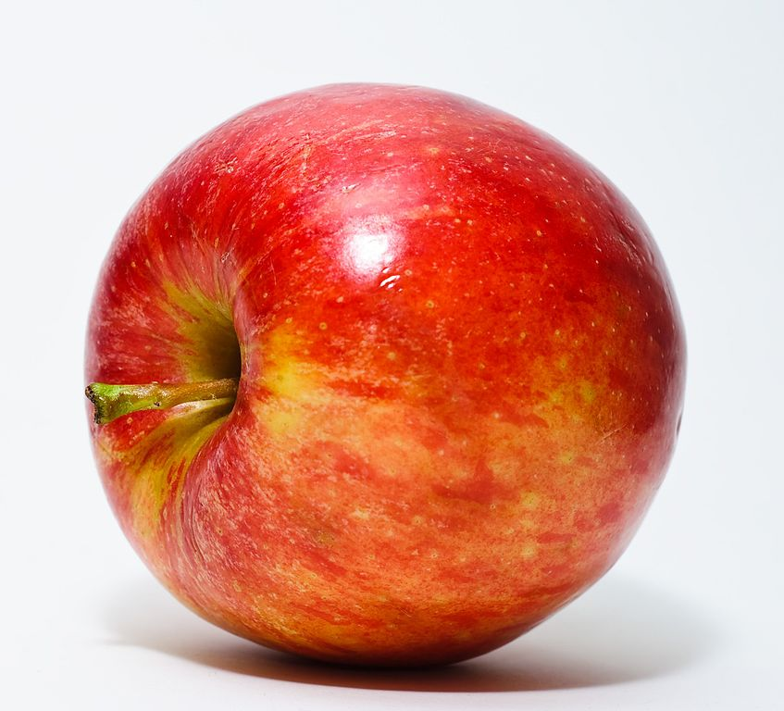
Activity: Step 2
Notes:
Look at this picture and then a look at the list you just wrote to describe the apple. Add to the list or delete from the list to make your list more precise.

Slide 96
Activity: Step 3
Notes:
[Hold up a red apple similar to the picture on the previous slide.] Look at this apple and further refine your list.
After a few minutes, lead a discussion:
How did your list change from when I simply wrote or said apple, to the picture of the apple, and now to this concrete representation of an apple?
How is this similar to concepts we teach in school? How can showing an apple or a block help a child understand the concept or skill?

Slide 97
Representations
Sweet Spot!
Concrete
Semi-concrete
Abstract
Communication! Natural and Mathematical Language
Notes:
When thinking about including multiple representations or CRA, teachers need to think about the sweet spot. That is, teachers need to understand when and how to incorporate different representations that make sense to develop student learning while also considering how to use the representations to increase communication and mathematical precise language and discourse. This process often can be challenging because it is not a linear process, and every skill does not require all three representations.

Slide 98
Encourage Students to Use Representations
Slide 10
Problem: You are planning a menu for a class party. Each student will receive one drink at the party. Your teacher tells you that, for a class this size, you can expect three of five students will prefer cola, whereas two of five will prefer lemonade. If, in fact, this guideline proves true for your class of 30 students, how many students will want cola? How many will want lemonade?
Reflect:
  How would your students think about this problem?
  Can you and your students represent a solution in more than one way? Are some solutions more powerful than others?
Show your response on Jamboard, using any available tools.
  Picture
  Virtual manipulatives
Notes:
[Read slide. Discuss and have teachers talk about how they would solve. Direct participants to Jamboard to solve.]
Here is a link to the Jamboard Template; make sure to update the notes with Jamboard link for this specific book study prior to the session:
https://jamboard.google.com/d/18fB8Iy1AT3CtBTkgZXN5hAv5W3kl8sMjGfI9_O8K57c/edit?usp=sharing

Slide 99

Encourage Students to Use Representations
How did this student solve?
How does the model show the answer?
How could a student continue to use this model for larger numbers?
C
C
C
C
C
C
C
C
C
C
C
C
C
C
C
C
C
C
L
L
L
L
L
L
L
L
L
L
L
L
$$\frac{2}{3}$$
Cola
Notes:
[Read slide. Facilitate a discussion.]

Slide 100


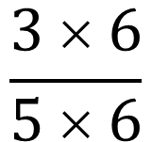


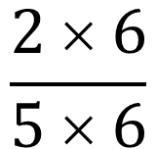


Encourage Students to Use Representations
$$\frac{3}{5}$$
$$\frac{?}{30}$$
How did the student solve?
How does the model show the answer?
Is this student’s answer more sophisticated than the answer of the previous student? Why or why not?
=
$$\frac{3 × 6}{5 × 6}$$
$$\frac{18}{30}$$
=
I need to order 18 colas.
$$\frac{2}{5}$$
$$\frac{?}{30}$$
=
I need to order 12 lemonades; 18 + 12 is 30, so my answer is right.
$$\frac{2 × 6}{5 × 6}$$
$$\frac{12}{30}$$
=
Notes:
[Facilitate discussion.] Although this student may have a more sophisticated answer, could the previous student solve a more complex problem with a picture alone?

Slide 101
Use of Representations to Communicate Thinking

Slide 102
Opportunities to Communicate Reasoning
Students need practice solving various mathematics problems, but they also need practice in communicating about mathematics so that it makes sense to themselves and peers.
Help students to
  work together to make sense of mathematics;
  rely more on themselves to determine whether something is mathematically correct;
  learn to reason mathematically;
  evaluate their own processes and engage in productive peer interaction;
  problem comprehension;
  learn to conjecture, invent, and solve problems;
  learn to connect mathematics, its ideas, and its application;
  persevere; and
  focus on the mathematics from the activities.
Notes:
The use of multiple representations can help students develop a conceptual understanding, but it also can act as a key tool to help them begin to talk about mathematics. [Read slide.]

Slide 103
Opportunities to Communicate Reasoning
Slide 11
Problem: If the cost of trading cards is two packs for $6, how much will it cost to buy 10 packs?
Write out a script of a conversation between teacher and student. Include Level 2 and 3 questions, as applicable. For example,
  “Teacher: I was walking around and saw a few different ways that students solved . . .”
  “Teacher: What could be another way to solve?”
Notes:
[Read slide. Discuss and have teachers talk about how they would solve. Direct participants to Jamboard to solve.]
In small groups (three to four) use Jamboard; then come back together to review.
Here is a link to the Jamboard Template; make sure to update the notes with Jamboard link for this specific book study prior to the session:
https://jamboard.google.com/d/18fB8Iy1AT3CtBTkgZXN5hAv5W3kl8sMjGfI9_O8K57c/edit?usp=sharing

Slide 104
Analyze the Problem
What symbols or notations are evident within the problem?
What vocabulary do students need to understand to solve the problem?
What are the prerequisite skills needed to solve?
What are some representations that could be used to increase student understanding of the problem or to assist in solving?
Notes:
[Read slide and facilitate discussion in small groups prior to solving.]

Slide 105

Discussion
How can representations increase student conceptual understanding?
How can you incorporate more representations into your classroom?
What resources or additional support are needed to increase your understanding and use of representations?
Notes:
[Read slide. Facilitate discussion.]

Slide 106
Next Steps

Slide 107
Homework
Complete the assigned reading: Chapter 5: “Evaluating Rules That Expire”
While reading, consider the following:
  Why have we previously relied on rules that expire (RTEs)?
  How might RTEs interfere with student learning?
  What supports do you have in place to help students determine if rules are generalizable?
Plan for our next session: DATE
Notes:
Add the date for the next session. [Read slide.]

Slide 108
Book Study
Session 5: Chapter 5: Why Was I taught That? Evaluating Rules That Expire

Slide 109
Agenda
Warm-Up
Rules That Expire
Understanding Word Problems
Reviewing Misconceptions
Next Steps
Notes:
[Read slide.]

Slide 110
Objectives
Inventory commonly used RTEs and provide instructional alternatives.
Describe the advantage of teaching a schema-based approach to word problems.
Identify the impact of keyword-focused instruction and strategies for solving word problems.
Notes:
[Read slide.]

Slide 111
Warm-Up

Slide 112
Solve
Mari said, “2h is always greater than h + 2.” Do you agree with Mari?
  Disagree because it is possible that 2h can be equal to or less than h + 2
  Disagree because multiplication is not the inverse of addition.
  Agree because multiplication always gives you a larger answer than addition.
  Agree because h is a positive number.
Notes:
Once again, let’s start with a warm-up to get our brain to be thinking mathematics. Take a moment to solve. Share your answer in the chat or unmute yourself and respond.

Slide 113

Let’s Discuss: Mari Problem
What are the key vocabulary needed to solve? What notation(s) are needed to solve?
What is the task asking us to do? What skills is it measuring?
What misconceptions does it address? How could you address or respond to misconceptions?
Why is this skill challenging for students?
Notes:
Now, consider the previous question. If we prompted students with this same question, consider the questions on the right.

Slide 114
Rules That Expire

Slide 115

I Wonder
What is the purpose of mathematics?
Notes:
[Facilitate discussion. Have participants share out loud and/or in the chat.]

Slide 116

Rules That Expire
Slide 12
Head to Jamboard; Slide 12
What RTEs are you guilty of teaching? (pink)
What rules do you have questions about or are surprised by? (green)
Lingering questions or aha moments (yellow)
Notes:
[Read slide. Discuss and have teachers talk about how they would solve. Direct participants to Jamboard to solve.]
Here is a link to the Jamboard Template; make sure to update the notes with Jamboard link for this specific book study prior to the session:
https://jamboard.google.com/d/18fB8Iy1AT3CtBTkgZXN5hAv5W3kl8sMjGfI9_O8K57c/edit?usp=sharing

Slide 117

Let’s Try It
Slide 13
At a party, 12 friends will share three whole pizzas. If each person is to get the same amount of pizza, how much of a pizza will each person get?
Which RTE does this refer to?
Using abstract and pictorial representations, how would you show your students to solve this problem?
Notes:
[Read slide. Discuss and have teachers talk about how they would solve. Direct participants to Jamboard to solve.]
Here is a link to the Jamboard Template; make sure to update the notes with Jamboard link for this specific book study prior to the session:
https://jamboard.google.com/d/18fB8Iy1AT3CtBTkgZXN5hAv5W3kl8sMjGfI9_O8K57c/edit?usp=sharing

Slide 118
Key Takeaways
RTEs are harmful.
  Appearance of success, especially for students who struggle
  Lack of mathematical flexibility because of a decrease in conceptual understanding
Need to develop both procedural fluency and conceptual understanding.
Perpetuate the negative perception and incorrect myth of mathematics as a set of disjointed ideas that are not connected to the world.
Students do not “grow out” of rules, and the long-term effects of teaching RTEs are very real.
Notes:
Read slide; prompt participants with this question: What other takeaways do you have?

Slide 119
Word Problems

Slide 120
What Is the Problem With Keywords?
What is the problem with these word problems?
The product of 3 and another number is 15. What is the other number?
Lizzy buys some groceries. All together her bill is $17. She pays with a $20, how much change does she get?
Michelle wonders how many groups she can make. She figures she can make 4 if there are 6 students in each. How many total students are there?
Bob has twice as many pets as Sarah. Bob has 10 pets. How many does Sarah have?
Notes:
[Read questions on the slide.]
What are some barriers to generalization and future success with this approach?

Slide 121

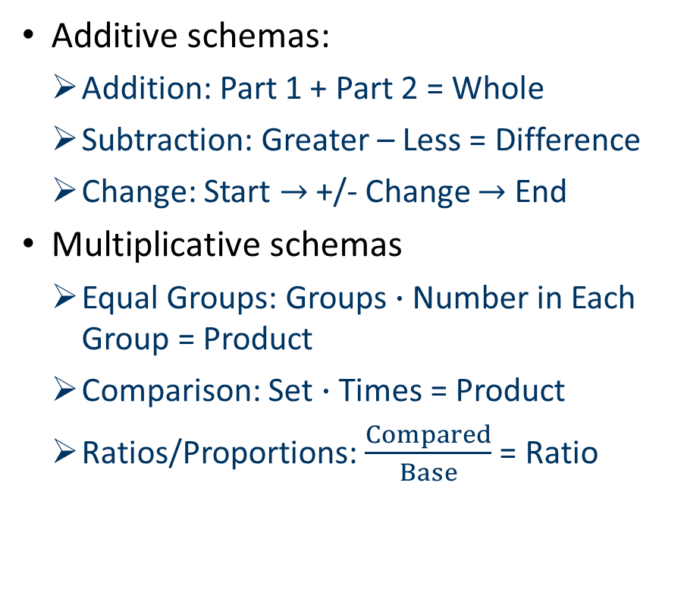
Schema-Based Instruction
Additive schemas:
  Addition: Part 1 + Part 2 = Whole
  Subtraction: Greater – Less = Difference
  Change: Start $→$+/- Change $→$ End
Multiplicative schemas
  Equal Groups: Groups $∙$Number in Each Group = Product
  Comparison: Set $∙$Times = Product
  Ratios/Proportions: $\frac{Compared}{Base}$ = Ratio
Combined schemas
  $\frac{+ or − Change}{Original}$ = Percentage Change
  Original +/- Change = New Total
Schema broadening
Source: https://iris.peabody.vanderbilt.edu/module/math/cresource/q2/p06/.
Notes:
How does the approach differ to keyword identification?
How will this impact student generalization of skills and future success?

Slide 122
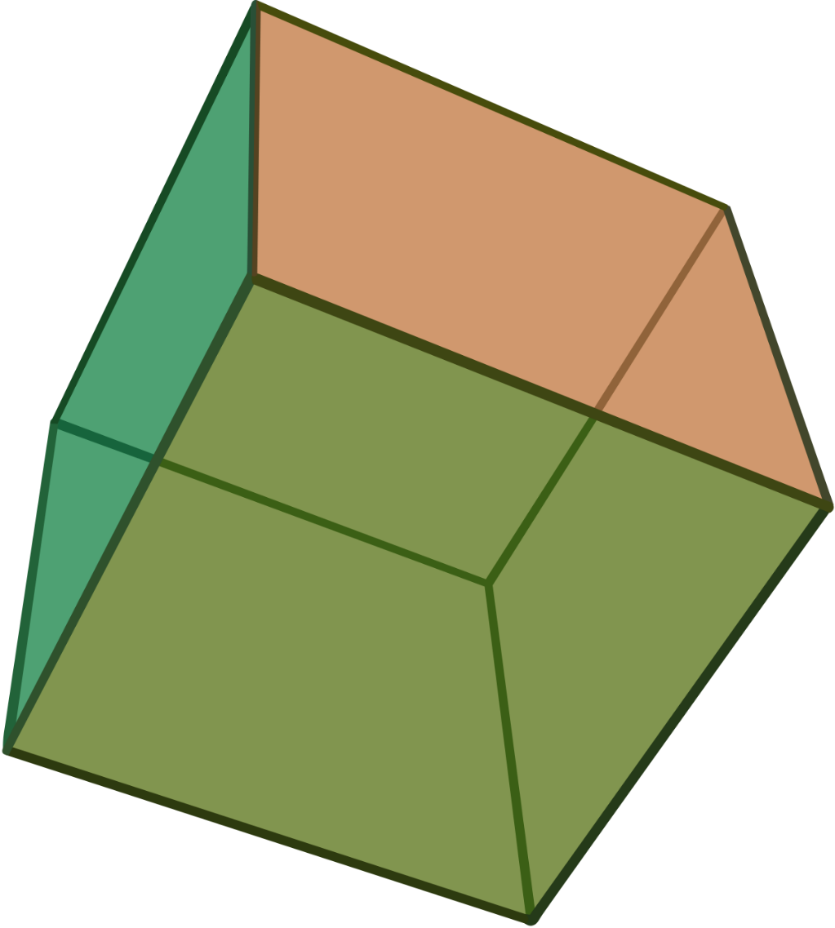
Putting It All Together:
Notations, Representations, Rules
Find the surface area of this cube.
What misconceptions do students bring to surface area questions?
Using abstract and pictorial representations, how would you show your students to solve this problem?
5
5
5
Notes:
Whole group discussion: Take a moment to solve the surface area of the cube,
Now consider the following:
What misconceptions do students bring to surface area questions?
Using abstract and pictorial representations, how would you show your students to solve this problem?

Slide 123
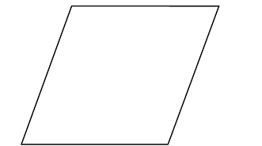
Solve
Slide 14
Draw two lines of symmetry for this rhombus.
Head over to Jamboard, slide 14. Select text box and write your answer.
Notes:
[Read slide. Discuss and have teachers talk about how they would solve. Direct participants to Jamboard to solve.]
Here is a link to the Jamboard Template; make sure to update the notes with Jamboard link for this specific book study prior to the session:
https://jamboard.google.com/d/18fB8Iy1AT3CtBTkgZXN5hAv5W3kl8sMjGfI9_O8K57c/edit?usp=sharing

Slide 124
Misconceptions

Slide 125
What Is the Problem?
Lack of conceptual understanding and RTEs
Misconceptions
Long-term mathematics struggles
Notes:
For students in middle school, their mathematics struggles often are not new. Meaning, students often lack conceptual understanding sometimes as a result of previous instruction that included RTEs, which led to misconceptions and gaps in key foundational skills. This explains why teachers at the middle school often are challenged to meet student needs.

Slide 126
Where Do You See the Greatest Breakdown?
Beliefs About Mathematics Education
Mathematics learning
Beliefs about mathematical problem solving
Beliefs About Self
Self-efficacy
Task-value beliefs
Beliefs About the Social Context
Norms in their own class
Role and functioning of the teacher and student
Control beliefs
Goal-orientation beliefs
Sociomathematical norms in class
Notes:
Consider these buckets of beliefs: beliefs about mathematics education, about self, and the social context. Using annotate, which belief do you see as the greatest challenge to changing or altering mathematics instruction?

Slide 127
Let’s Discuss
Where are students struggling?
  Understanding?
  Procedures?
  Motivation?
  Confidence?
How have you grown as a teacher as we have read the chapters?
What are your strengths as a teacher?
What are areas of improvement?
Notes:
[Read slide and facilitate discussion.]

Slide 128
Next Steps

Slide 129
Homework
Read
  Chapter 6: “Watching What We Say! Using Correct and Consistent Language”
  Article: “Developing Concepts and Generalizations”
While reading, consider the following:
  Why is generalization important?
  How do generalizations support student reasoning and pattern identification?
  What are you currently doing to facilitate class discussions and tasks that support generalization?
Plan for our next session: DATE
Notes:
[Add the date for the next session and any other pertinent information. Read the slide and highlight important information.]

Slide 130
Book Study
Session 6: Chapter 6: Building Generalizations: Developing Instructional Strategies the MWSA Way

Slide 131
Agenda
Warm-Up
Overgeneralization and Instructional Strategies
Student Characteristics and Challenges
Next Steps
Notes:
Today we will discuss Chapter 6: “Building Generalizations: Developing Instructional Strategies the MWSA Way.” Here is an overview of our session [read slide].

Slide 132
Objectives
Describe the differences between generalizations and rules.
Promote how generalizations support student reasoning and pattern identification.
Identify tasks and strategies that promote student skill generalization.
Recognize common student struggles and EBPs that promote learning.
Notes:
By the end of today’s session, we hope to achieve these objectives [read slide].

Slide 133
Warm-Up

Slide 134
Number Sort
Slide 15
In small groups, identify different ways to sort these number expressions. Try to identify at least three different ways to sort. Source:
6 - 4
5 + 6
11 – 2
12 + 3
5 – 7
1 – 10
0 + 5
2 – 9
5 – 0
7 – 5
4 + 11
3 – 12
Source: https://math4teaching.com/introducing-negative-numbers/.
Notes:
We will start with a mathematical sorting warm-up to help link to the material that we read for today’s session.
[Read slide. Discuss and have teachers talk about how they would solve. Direct participants to Jamboard to solve.]
Here is a link to the Jamboard Template; make sure to update the notes with Jamboard link for this specific book study prior to the session:
https://jamboard.google.com/d/18fB8Iy1AT3CtBTkgZXN5hAv5W3kl8sMjGfI9_O8K57c/edit?usp=sharing

Slide 135
Number Sort: Generalization
How did you and your group sort?
What previous knowledge did you bring to this task?
What did you notice about the expressions? What would your students notice?
How would you teach this skill, without simply expressing it as a rule?
  What questions would you ask?
  What activities would you include?
Notes:
[Read slide. Facilitate discussion.]

Slide 136
Overgeneralizations and Instructional Strategies

Slide 137

Jamboard Question
Slide 16
What is the difference between a rule and a generalization?
Notes:
[Read slide. Discuss and have teachers talk about how they would solve. Direct participants to Jamboard to solve.]
Here is a link to the Jamboard Template; make sure to update the notes with Jamboard link for this specific book study prior to the session:
https://jamboard.google.com/d/18fB8Iy1AT3CtBTkgZXN5hAv5W3kl8sMjGfI9_O8K57c/edit?usp=sharing

Slide 138
Generalizations Versus Rules
Generalization
  The act or process of generalizing
  A result of this process; a general statement, idea, or logic
Rule
  A principle or regulation governing conduct, action, procedure, arrangement
  A code of regulations
Consider the definitions and what we brainstormed. What is the greatest difference between a generalization and a rule?
Notes:
[Read slide. Facilitate discussion.]

Slide 139

Developing Generalizations
Stem from student experiences
Make mathematics more meaningful through explicit patterns and tasks
Three steps:
  Identify commonalities across multiple examples or cases.
  Extend reasoning.
  Derive more general ideas or results from specific examples or cases.
Notes:
[Read slide.]

Slide 140
Tasks to Promote Generalizations
Type of task | Definition | Example
Reversibility tasks | Tasks that cause students to reverse their thinking; giving the answer and having students construct the task. | Find an equation using a variable whose solution is -8.
Flexibility tasks | Tasks that require multiple solution processes or that promote identifying relationships between and across problems. | Solve the system of equations y = -x + 6 and y = 3x + 2 by graphing. Solve it by substitution. How the methods alike? How are they different?
Generalization tasks | Tasks that ask students to identify and formalize a pattern from multiple cases or find a specific example given a generalization. | Find two trinomials whose sum is a monomial. Find two trinomials whose sum in a binomial. Find two trinomials whose sum is a trinomial.
Source: Adapted from Dougherty et al. (2015).
Notes:
[Read slide.]

Slide 141
Practice
Slide 17
What is an equation with a variable on both sides of the equals sign that has a solution of x = -5?
Solve each equation:
2x – 8 = 24
x – 8 – 8 = 16 – x
4x – 8 + 2 = 26 + 2x
What is something you notice about these equations?
Notes:
Consider these problems and the types of questions we just reviewed. How are these problems alike? How are they different?

Slide 142
Task Sort: Three Groups
Slides 18, 19, 20
Review the tasks
  Group 1: Jamboard Slide 18
  Group 2: Jamboard Slide 19
  Group 3: Jamboard Slide 20
Determine if the task is simply looking for an answer/computation or if it is a
  reversibility,
  flexibility, or
  generalization task.
If it is just a computation problem, modify the task to be a reversibility, flexibility, and/or generalization task.
Notes:
We will practice sorting questions by reversibility, flexibility, generalization, or a basic computational problem. There is no right answer; rather, this is a time for us to learn, discuss, and practice so that we can begin to think about how to bring in different types of questions into your classes.

Slide 143

Let’s Discuss
Share how your group sorted the original tasks.
Did you need to change or modify any tasks?
What was challenging about this activity?
How could you use this activity with peers or students?
Notes:
[Read slide. Facilitate discussion.]

Slide 144
Student Characteristics and Challenges

Slide 145
What Is the Problem?
Lack of conceptual understanding, foundational skills, basic facts, working memory, inability to generalize across skills . . .
Misconceptions and RTEs
Long-term mathematics struggles
Notes:
We saw this slide in a previous section. As we have read and learned more about our own mathematics instruction and challenges faced by students, where do you see the greatest challenge?

Slide 146
Review: Evidence-Based Practices
Systematic Instruction
Mathematical Language
Representations
Number Lines
Word Problems
Timed Activities
Source: Fuchs et al. (2021).
Notes:
For more information about evidence-based practices, the Institute for Education Sciences (IES) and the What Works Clearinghouse have created practice guides. This practice guide outlines six practices that can support students struggling in mathematics. Although the title states elementary, all of these practices can and should be part of middle school intervention and core classrooms. These include the use of systematic instruction, mathematical language. use of representations, use of number lines, word problem instruction, and regularly timed activities. How many of these practices are currently part of your instruction?

Slide 147
Evidence-Based Practices: Grades 6–12
Use Solved Problems
Utilize the Structure of Algebraic Representations.
Teach Students to Intentionally Choose Alternative Strategies
Source: Star et al. (2015); revised in 2019.
Notes:
Another practice guide focuses specifically on evidence-based practices in middle schools. As mentioned on the previous slide, this is another practice guide that shows solving worked problems and word problems, teaching students to use algebraic structures, and choosing strategies for solving problems are all EBPs. Many teachers often question the role of evidence, what about the practices that are minimal? The IES process is very stringent and applies high standards for judging intervention studies, as they should, which means that if a practice is even minimal, it often contains more evidence than programs or other instructional programs in schools.

Slide 148
Tasks, Evidence-Based Practices, and Your Teaching
What are your strengths in teaching?
  Identifying tasks?
  Embedding EBPs?
  Discourse?
Where do you need the most support?
What information, examples, articles, and so forth, would you like to focus on during the next two sessions?
Notes:
[Read slide and facilitate discussion.]

Slide 149
Next Steps

Slide 150
Next Steps
Assigned readings:
  Chapter 7: “Embodying the MWSA in Every Lesson: No Teaching by Telling!”
  Pick one article to read:
    “When Students Use Technology Tools, What Are You Noticing?”
    “Launching a Mathematical Model Lesson”
While reading, consider the following:
  To what extent do your lessons and units already embody some of the ideas?
  How can collaboration and discourse further student learning?
  How have you previously integrated new learning approaches into your instruction?
Attend next session: DATE
Notes:
Add date for the next session. See Resource list for link to articles. [Read slide.]

Slide 151
Book Study
Session 7: Selected Articles and Chapter 7: Embodying the MWSA in Every Lesson: No Teaching by Telling!

Slide 152
Agenda
Warm-Up
Article Discussion
Creating a Collaborative Culture
Next Steps
Notes:
[Read slide.]

Slide 153
Objectives
Describe how collaboration can impact student learning.
Identify elements that cultivate collaboration.
Discuss ways to integrate these ideas and begin classroom implementation.
Notes:
[Read slide.]

Slide 154
Warm-Up

Slide 155
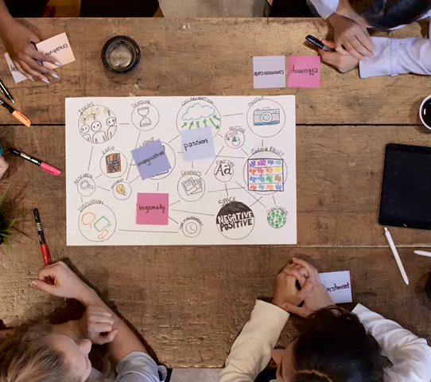
Warm-Up
Take a moment to think about collaboration, both within your school role and beyond
Share out
  What currently helps support or cultivate collaboration?
  How do you approach the barriers to collaboration?
Notes:
[Read slide.] Today’s warm-up will be a discussion rather than a mathematical problem. We have been spending a lot of time learning and practicing mathematics together, rather than alone. Think about your role at your school. How often do you have an opportunity to learn with peers? Collaborate between general and special education?

Slide 156
Article Discussion

Slide 157

Jigsaw: Article Review
Slide 1 or 2
Launching a Mathematical Modeling
Lesson
When Students Use Technology Tools, What Are You Noticing?
Notes:
We will go to breakout rooms depending on the article you read. Take 8 minutes to chat about key insights and takeaways and then add notes to your slide on Jamboard.
Slide 1: When Students Use Technology Tools, What Are You Noticing?
Slide 2: Launching a Mathematical Model Lesson
Jamboard 2 (new Jamboard link)
https://jamboard.google.com/d/1Ms2L_2Au57MioNRY9auy_lyC_YBjtY9UEZN_e22-2pE/edit?usp=sharing

Slide 158

Discussion
What are two key takeaways from your reading that you would like to share with the other group?
How did the readings connect to your current teaching?
Notes:
Once you bring the groups back together, have each group share two takeaways with the participants who read a different article.

Slide 159
Creating a Collaborative Culture

Slide 160
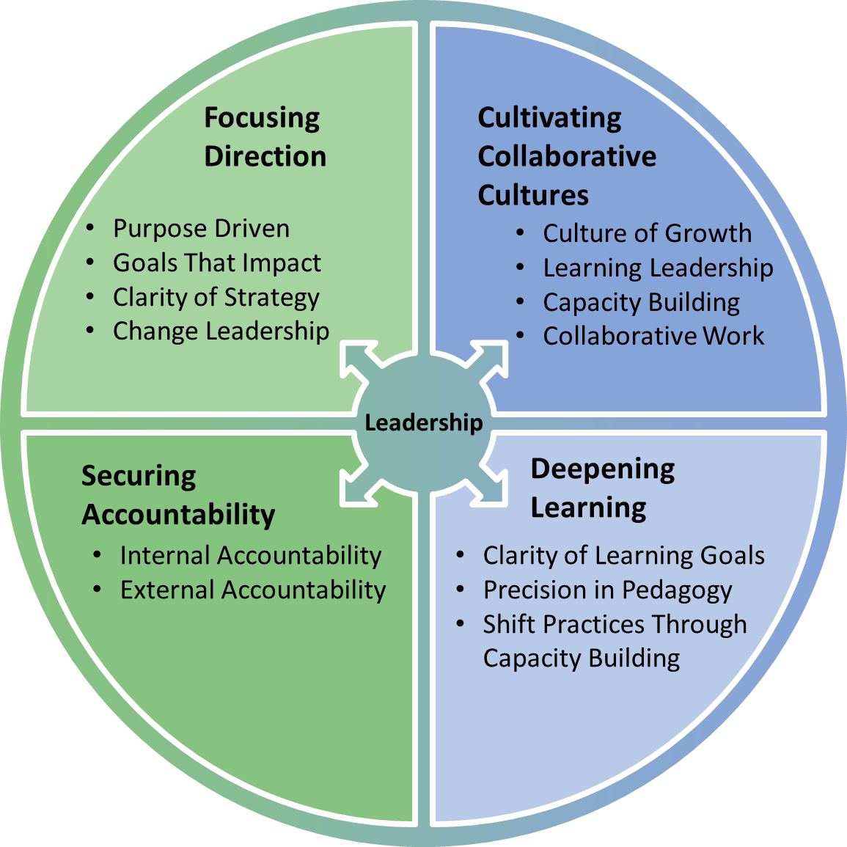
Coherence Framework: Right Drivers
Source: Fullan & Quinn (2016).
160
Notes:
We have been discussing changing our own mathematics instruction, but it is hard to live in a bubble. The key within the Math Pact is that it is more than just you; it is a team that is willing to be vulnerable and willing to change instructional practices to meet student needs. It also is about creating a culture that allows you to be open and honest in admitting that you may need more support. This slide is an example of the ideal coherence system components. Consider how each area has been part of our book study. For example, we have focused direction on EBPs, and we have deepened our learning of how to teach mathematics. In addition, we have grown as a team, collaborating across schools, grade levels, and general and special education. Accountability refers to more than just assessments; it is the accountability of learning, reading, discussing, and approaching your teaching with the understanding that you do not know everything and always want to learn.

Slide 161

Let’s Discuss
Coherence is the underlying foundation of changing instructional practices, the Math Pact. Think about coherence at your current district.
  How easily could you enact the Math Pact in your school?
  What messages are you receiving (email, professional development sessions, coaching) that are the same or different from what we are learning this semester?
Notes:
[Facilitate discussion.]

Slide 162
Four Elements of Cultivating Collaboration
Culture of Growth
Learning Leadership
Capacity Building
Collaborative Work
Source: Fullan & Quinn (2016).
Notes:
Using annotate, mark the area of cultivating a coherence system that you feel is strong at your school. Using a different stamp, what is an area that you see as an area of improvement or would like additional support?

Slide 163

Let’s Discuss
What is your current challenge(s) within mathematics instruction?
How does your school/department view collaboration?
How can you become a learning leader of high-quality, evidence-based mathematics instruction?
What kind of support would be ideal to offer a similar book study and/or start the Math Pact at your school?
Notes:
[Facilitate discussion.]

Slide 164
Next Steps

Slide 165
Next Steps
Read Chapters 8 and 9
While reading, consider the following:
  How has or how will your instruction change?
  How will you share the information that you learned?
  What is the greatest takeaway from this study?
  As I reflect on these experiences, what can I pull from them to facilitate forward momentum in my setting?
Attend next session: DATE
Notes:
Add the date for the next and final session. [Read slide.]

Slide 166
Book Study
Session 8: Chapter 8: Getting to the Heart of the Matter: Building and Enacting the MWSA and Chapter 9: Sharing Successes From the Field: MWSA Heroes Tell Their Stories

Slide 167
Agenda
Warm-Up
Putting It All Together
Closing Thoughts
Notes:
Today in our final session. We will discuss Chapter 8: “Getting to the Nitty Gritty: Building and Enacting the MWSA” and Chapter 9: “Sharing Successes From the Field: MWSA Heroes Tell Their Stories!”

Slide 168
Objectives
Identify Math Pact principles and specific EBPs that support student learning in mathematics.
Reflect on your plan for incorporating principles from the book into your mathematics instruction.
Notes:
[Read slide.]

Slide 169
Warm-Up

Slide 170
Math Pact Components Continuum
Still Need Support
Feeling Confident
Language
Notation
Representations
Rules
Generalizations
Instructional Strategies
Notes:
Consider the Math Pact Components Continuum features listed here. Use the annotation feature or share out your confidence in implementing or supporting these features.
Additional questions for discussion:
How has your confidence in these areas changed since the beginning?
Are there particular chapters or readings that stand out or that you feel had a strong impact?

Slide 171
Putting It All Together

Slide 172
Let’s Try it Together
You are planning a family trip to an amusement park. For all roller coasters, you must be at least 54 inches tall to ride. For water rides, you must be at least
48 inches tall to ride. For some of the kiddie rides, you must be between 36 and 52 inches tall to ride. Represent the height requirements of each ride with inequalities and represent each on a number line. Is it possible to ride all rides in the park? If so, who may ride all the rides?
Notes:
[Read slide.] Consider this problem. We will first answer some questions and then look at some student work to discuss the level of understanding.

Slide 173
Applying What We Learned
First
  What is/are the skill(s) being taught?
  How would you have taught the skill? Think about the “sweet spot” and hitting all three representations within the lesson.
Second
  What did the student do? What misconceptions is the student displaying?
  What do we want to ask the students?
  What might we do next, instructionally? Consider how you might need to differentiate or consider what skills may need to be retaught.
Notes:
[Read slide.]

Slide 174
Jamboard: Reviewing Student Work
Slides 3 and 4
Look at the student work.
Answer the questions
  What is/are the skill(s) being taught?
  How would you have taught the skill? Think about the “sweet spot” and hitting all three representations within the lesson.
  What did the student do? What misconceptions is the student displaying?
  What do we want to ask the students?
  What might we do next, instructionally? Consider how you might need to differentiate or consider what skills may need to be retaught.
Be prepared to share with the group.
  Group 1: Jamboard 2, Slide 3
  Group 2: Jamboard 2, Slide 4
Notes:
Jamboard 2
https://jamboard.google.com/d/1Ms2L_2Au57MioNRY9auy_lyC_YBjtY9UEZN_e22-2pE/edit?usp=sharing

Slide 175
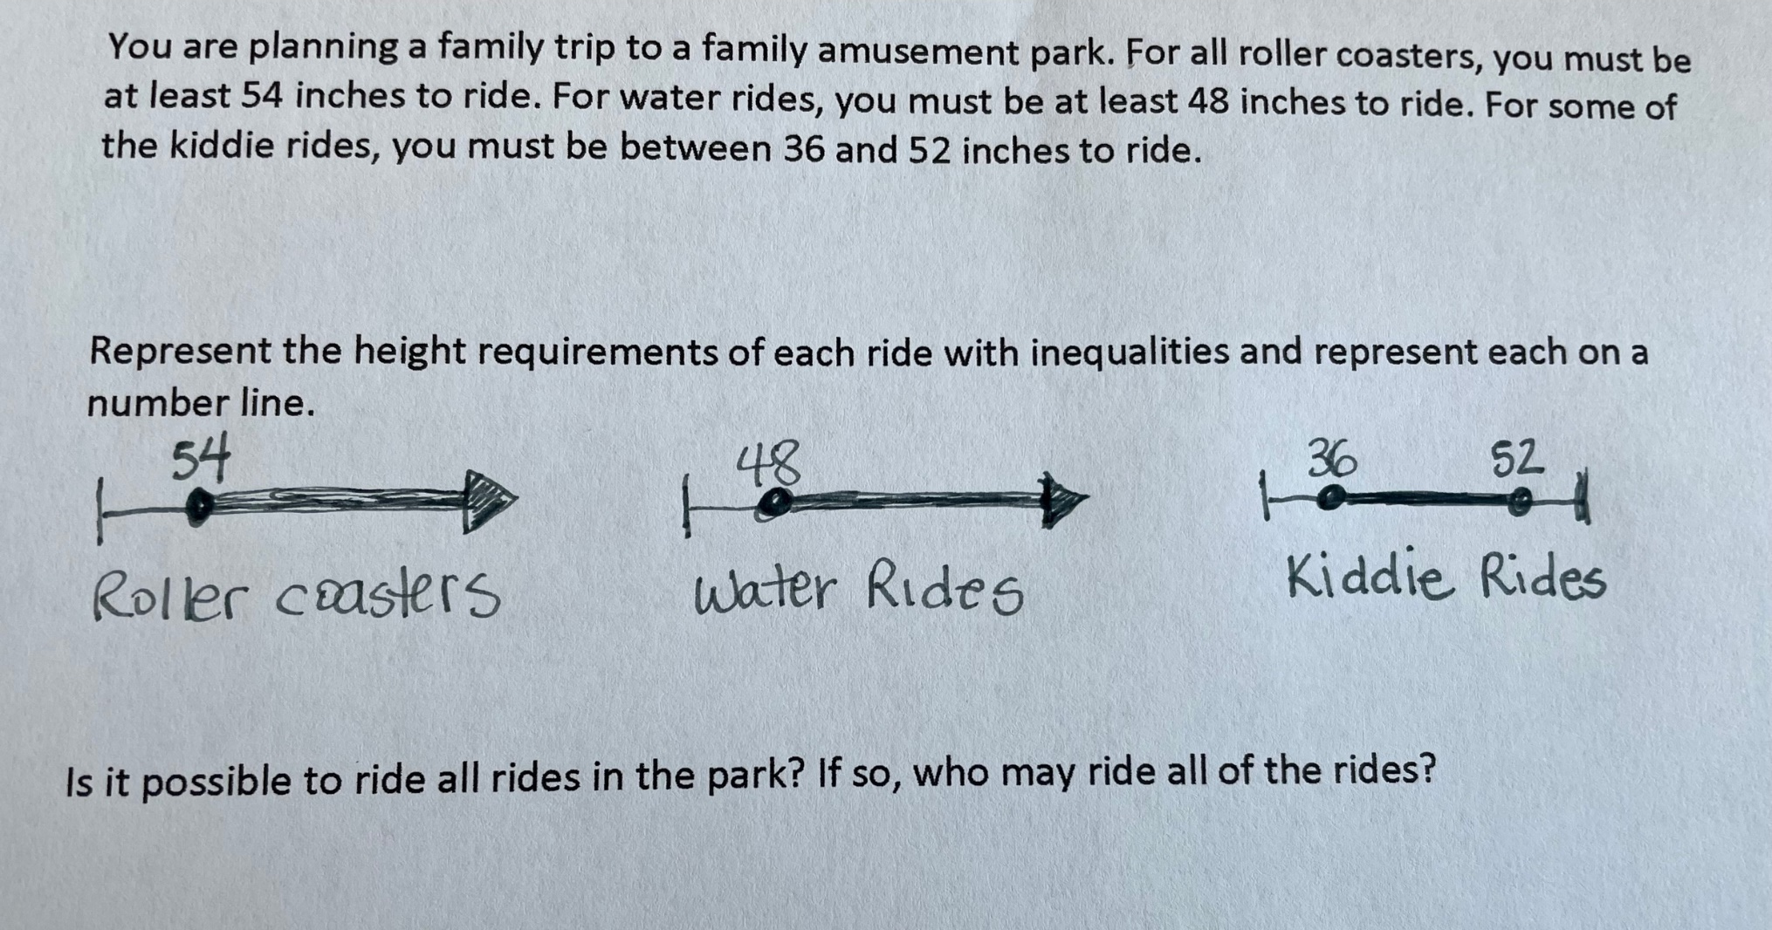
Student 1’s Work: Let’s Review
Source: Big Idea 28: Inequalities • Task A
SanGiovanni & Novak (2018)
Notes:
Review this student’s work. How did they solve? What do you notice about the number lines drawn? How could these diagrams impact the student's ability to discuss and understand the problem?

Slide 176
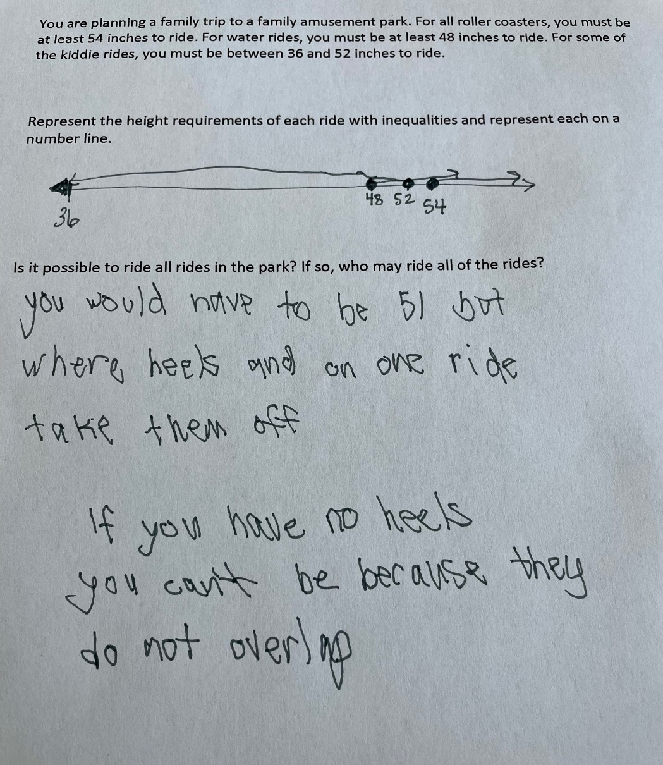
Student 2’s Work: Let’s Review
Source: Big Idea 28: Inequalities • Task A
SanGiovanni & Novak (2018)
Notes:
Now look at this student’s answer. Rather than create three separate diagrams, this student drew it on one number line. How would you describe this student’s understanding versus the first student? What could make this diagram better? This student did answer the follow-up question; is it possible to ride all the rides in the part? Is so, who may ride all the rides? The response is, “you would have to be 51 but wear heels and on one ride take them off. If you have no heels, you can’t be because they do not all overlap.” How would you describe this student’s understanding after seeing the follow-up question’s response?
Source: Big Idea 28: Inequalities • Task A Retrieved from the companion website for Mine the Gap for Mathematical Understanding, Grades 6–8: Common Holes and Misconceptions and What To Do About Them by John SanGiovanni and Jennifer Rose Novak. Thousand Oaks, CA: Corwin, www.corwin.com. Copyright © 2018 by Corwin. All rights reserved. Reproduction authorized only for the local school site or nonprofit organization that has purchased this book.

Slide 177
Teacher Role: Pre-Post Math Pact
As we reviewed the student work and your responses, how has your response to this student work changed?
What is the role of the Math Pact components within the instruction? How would you specifically bring in the components when supporting the students from the previous slide?
Notes:
[Facilitate discussion.]

Slide 178
Closing Thoughts

Slide 179

Closing Thoughts
How has or how will your instruction change?
How will you share the information that you learned?
What is the greatest take-away from completing this book study?
Notes:
[Facilitate discussion.]

Slide 180

Professional Growth
Slide 5
Reflect on your growth during this book study and complete the following:
  We are most proud of . . .
  We are most surprised by . . .
  We still need to work on . . .
Add your thoughts on Jamboard.
Notes:
[Read slide.]
Jamboard 2
https://jamboard.google.com/d/1Ms2L_2Au57MioNRY9auy_lyC_YBjtY9UEZN_e22-2pE/edit?usp=sharing

Slide 181
Disclaimer
This material was produced under the U.S. Department of Education, Office of Special Education Programs, Award No. H326M170002 and adapted under the Special Education – Technical Assistance and Dissemination to Improve Services and Results for Children with Disabilities; Model Demonstration, U.S. Department of Education, Award No. 84.326M.​​
The views expressed herein do not necessarily represent the positions or policies of the U.S. Department of Education. No official endorsement by the U.S. Department of Education of any product, commodity, service, or enterprise mentioned in this website is intended or should be inferred.​

Slide 182
References
Baddeley, A. D., & Logie, R. H. (1999). Working memory: The multiple component model. In A. Miyake & P. Shah (Eds.), Models of working memory (pp. 28–61). Cambridge University Press.
Dougherty, B. J., Bryant, D. P., Bryant, B. R., Darrough, R. L., & Pfannenstiel, K. H. (2015). Developing concepts and generalizations to build algebraic thinking: The reversibility, flexibility, and generalization approach. Intervention in School and Clinic, 50(5), 273–281. https://files.eric.ed.gov/fulltext/ED577155.pdf
Fuchs, L. S., Bucka, N., Clarke, B., Dougherty, B., Jordan, N. C., Karp, K. S., Woodward, J., Jayanthi, M., Gersten, R., Newman-Gonchar, R., Schumacher, R., Hammond, K., Lyskawa, J., Keating, B., & Morgan, S. (2021). Assisting students struggling with mathematics: Intervention in the elementary grades (WWC 2021006). U.S. Department of Education, Institute of Education Sciences, National Center for Education Evaluation and Regional Assistance. https://ies.ed.gov/ncee/wwc/Docs/PracticeGuide/WWC2021006-Math-PG.pdf
Fullan, M., & Quinn, J. (2016). Coherence: The right drivers in action for schools, districts, and systems. Corwin Press.
Geary, D. C. (2004). Mathematics and learning disabilities. Journal of Learning Disabilities, 37(1), 4–15. https://doi.org/10.1177/00222194040370010201

Slide 183
References
Molina, C. (2012). The problem with math is English: A language-focused approach to helping all students develop a deeper understanding of mathematics. Jossey-Bass.
SanGiovanni, J., & Novak, J. R. (2018). Mine the gap for mathematical understanding: Grades 6–8. Corwin Press.
Siegler, R. S. (1988). Strategy choice procedures and the development of multiplication skill. Journal of Experimental Psychology: General, 117(3), 258–275. https://doi.org/10.1037/0096-3445.117.3.258
Star, J. R., Foegen, A., Larson, M. R., McCallum, W. G., Porath, J., Zbiek, R. M., Caronongan, P., Furgeson, J., Keating, B., & Lyskawa, J. (2015). Teaching strategies for improving algebra knowledge in middle and high school students (NCEE 2015-4010). U.S. Department of Education, Institute of Education Sciences, National Center for Education Evaluation and Regional Assistance. https://ies.ed.gov/ncee/wwc/docs/practiceguide/wwc_algebra_040715.pdf
Wehmeyer, M. L. (1992). Self-determination and the education of students with mental retardation. Education and Training in Mental Retardation, 27, 302–314. https://files.eric.ed.gov/fulltext/ED470036.pdf

