Slide 1
Embedding Multiple Representations in Middle School Mathematics Classrooms
Expanding Middle School Students’ Understanding of Algebraic Reasoning for Students With Disabilities
American Institutes for Research
Notes:
This module focuses on the importance of incorporating multiple representations into mathematical tasks that lead to conceptual understanding, increased student discussion, and overall discourse in middle school mathematics classes. Many students with disabilities (and others who struggle) lack the prerequisite skills, vocabulary, and working memory to actively engage or link mathematical concepts (Fuchs et al., 2021). The limited engagement and conceptual understanding can further widen the academic gap. This module is designed to be completed during a full-day professional development session, or it may be broken into smaller chunks. The mathematics problems are designed to be completed with partners or in small groups and then discussed with the larger group.
Instructions for using the speaker notes
• Text formatted in standard font is intended to be read aloud or paraphrased by the facilitator.
• Text formatted in italics is intended as directions or notes for the facilitator; italicized text is not meant to be read aloud.
Welcome participants to the training. Introduce yourself (or yourselves) as the facilitator(s) and briefly cite your professional experience in mathematics instruction and supporting students who struggle and students with disabilities in mathematics.
Although permission to reprint this publication is not necessary, the citation should be as follows: American Institutes for Research. (2022). Embedding multiple representations in middle school mathematics classrooms: Expanding middle school students’ understanding of algebraic reasoning for students with disabilities. U.S. Department of Education, Office of Special Education Programs.

Slide 2
Objectives
Participants will
gain knowledge about national trends in mathematics,
discuss the importance of specially designed instruction to support students with disabilities,
learn the importance of embedding multiple representations to build conceptual understanding for all students, and
learn the importance of leveraging multiple representations within mathematics lesson planning.
Notes:
[Read slide.] This is a suggested agenda and can be altered to fit your needs.

Slide 3
National Trends in Mathematics
Notes:
[Read slide.]

Slide 4
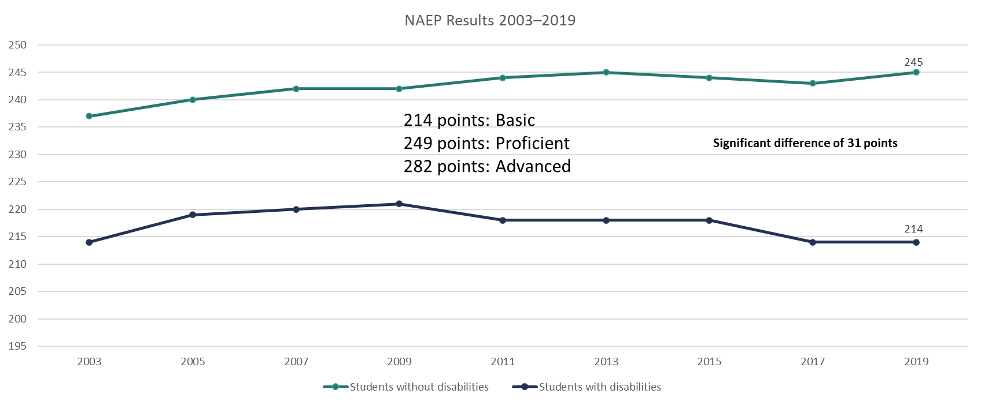
National Mathematics Trends: National Assessment of Educational Progress Grade 4
NAEP = National Assessment of Educational Progress.
Notes:
As you can see, between 2003 and 2019, a significant gap exists between scores of fourth-grade students with and without disabilities on the NAEP. Most students with disabilities score at the basic level; those without disabilities score at almost the proficient level. This gap has not decreased across time and, in fact, has increased. These results are for grade 4, but how might these skill gaps impact students in middle school?

Slide 5
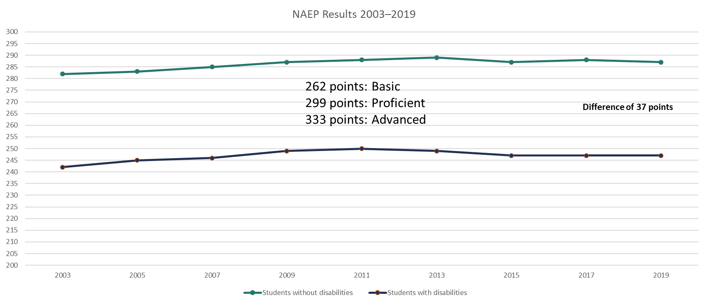
National Mathematics Trends: NAEP Grade 8
Notes:
From grade 4 to grade 8, we see little difference, meaning the gap between students with disabilities and students without disabilities is not closing and is, in fact, widening.

Slide 6
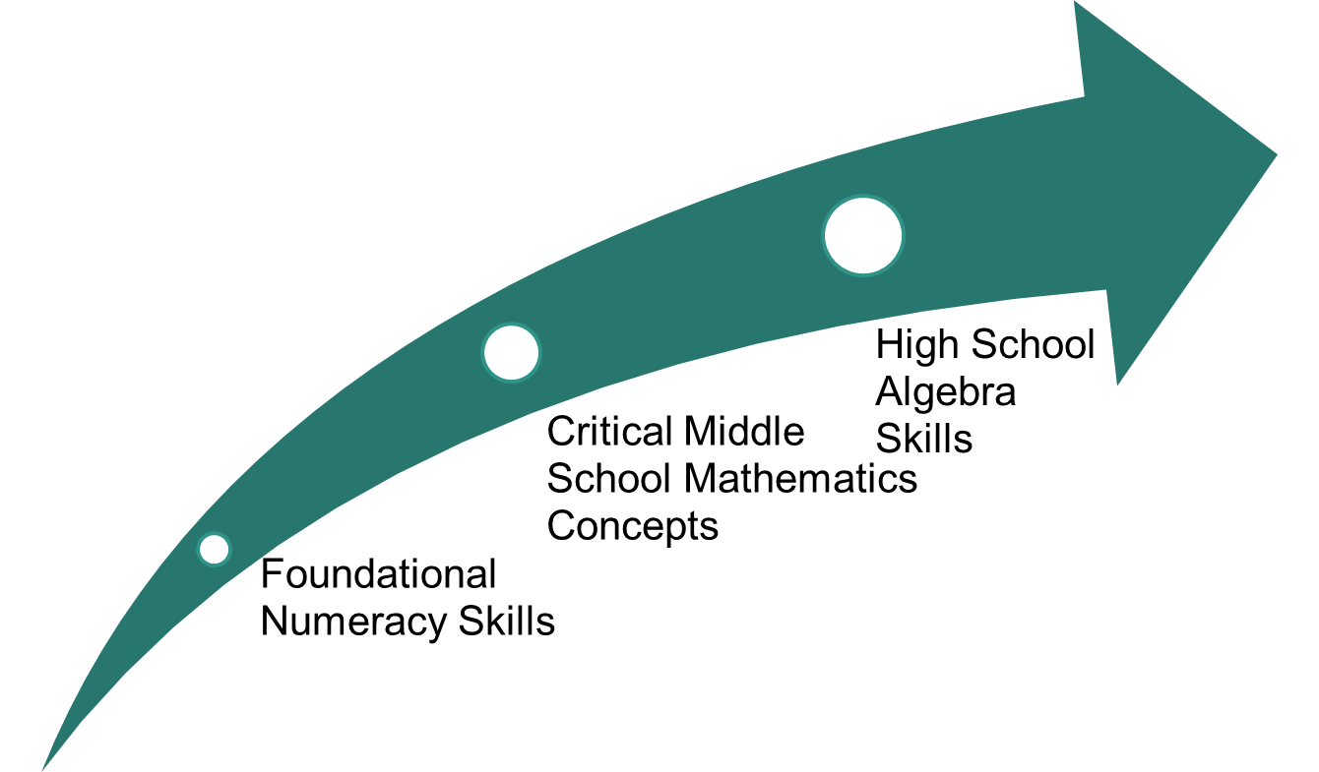
Developing Foundations of Algebra
Notes:
Schools are providing support, yet the persistent gaps between students with disabilities and those without disabilities still exist. Mathematics is an area in which the skills are highly interconnected, so when students do not fully develop the foundational skills in elementary school, their learning becomes filled with misconceptions, or they lack conceptual understanding. As mathematics becomes more challenging, the holes and misconceptions in student understanding affect concept development in middle school, which can hinder student understanding of algebraic concepts in high school. This situation becomes a problem because algebra is considered the gateway to other mathematics classes and often is the prerequisite for many postsecondary classes.

Slide 7
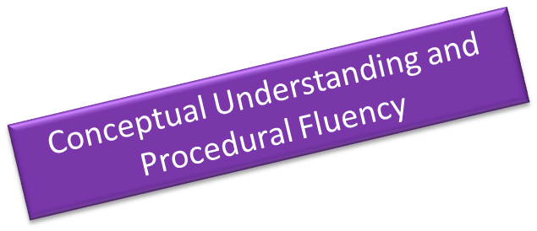
Foundational Skills That Lead to Algebra Success
Fluency with whole numbers​
Automatic recall of addition, subtraction, multiplication, and division facts​
Standard algorithms ​
Estimation and reasonableness​
Fluency with fractions​
Positive and negative fractions​
Locate fractions on a number line​
Computations of fractions​
Decimals, fractions, and percent​s
Geometry and measurement​
Slope of a straight line​
Properties of two- and three-dimensional shapes​
Volume, area, and surface area​
https://achievethecore.org/coherence-map/; http://www.corestandards.org/Math/
Notes:
The key, regardless of the skill, is to develop conceptual understanding alongside procedural fluency! We need to consider how we instruct students; how do you get students to conceptually understand the mathematics? [Click for animation.] The key is to develop students’ conceptual understanding and procedural fluency so that they can be successful in the long term, not just for a particular grade level.

Slide 8
Mathematics Is Interconnected!
Mathematical standards are not stand-alone skills. They build on standards
within the same grade level and
across grade levels.
As students get older, the gaps within and across grade levels increase, which can result in
less conceptual understanding;
the development of misconceptions; and
greater need for intervention support.
Notes:
As indicated on the previous slide, many students with mathematics difficulties develop gaps in learning and misconceptions that hinder conceptual understanding. We often see greater skills gaps in middle school when standards often are more difficult and connected to previous standards and when students show an inability to generalize previous skills to more demanding tasks.

Slide 9
Specially Designed Instruction
Supporting Students in Special Education

Slide 10
Let’s Chat
How do special and general educators collaborate to meet student needs?
How are you currently providing support to students with disabilities and students who struggle? How are you ensuring that students develop conceptual understanding and procedural fluency?
Notes:
[Read slide. Have participants discuss in pairs or small groups and then share.]

Slide 11
What Is Specially Designed Instruction?
Specially designed instruction (SDI) is adapting content, methods, and/or instructional delivery to meet the unique needs of a student.
Different from Universal Design for Learning (UDL) and differentiation because the student needs it ALL the time to access education; and
SDI can look, feel, and include differentiation and scaffolding, the difference is that it is required and a necessity for students in special education.
IEP Tip Sheet: Overview of the Statement of Services & Aids
Notes:
We often think of specially designed instruction or SDI as differentiation or simply providing accommodations. SDI is mandated by special education law, the Individuals with Disabilities Education Act (also known as IDEA), and should be part of a student’s individualized education program (IEP). SDI is the answer to what makes special education special because it is something that a student needs all the time, not occasionally.

Slide 12
Differentiation and Scaffolding
Differentiation means tailoring instruction to meet individual needs. Teachers can differentiate content, process, products, or the learning environment, based on individual student needs.
Scaffolding provides students with supports that help them accomplish goals in a step-by-step process. It also may be considered an approach to differentiation.
Notes:
In many cases, differentiation and scaffolding are used interchangeably because they are both part of Universal Design for Learning or UDL, yet they are different. Differentiation often is used for individual student needs, whereas scaffolding is applied to an entire class or just an individual student. The key takeaway is that these instructional practices should be part of teaching for ALL students, regardless of special education status.

Slide 13
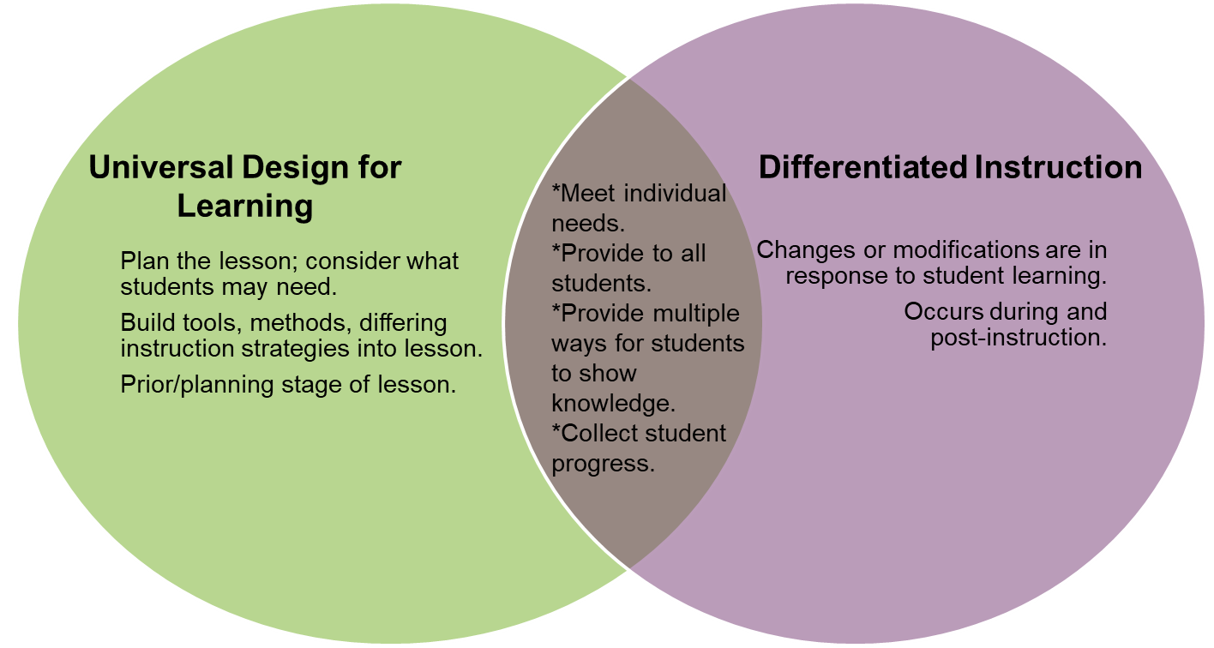
Universal Design for Learning Versus Differentiation
UDL is an overarching approach focused on the inclusive design of the environment.
Differentiation is a strategy aimed at addressing individual levels of readiness, interest, and learning profiles.
https://www.inclusive.tki.org.nz/guides/universal-design-for-learning/udl-and-differentiation-and-how-they-are-connected
Notes:
[Read slide.]

Slide 14
Leveraging All Educators to Provide SDI, UDL, and Differentiation
Special Educator
Expertise in how students with disabilities experience barriers in accessing curriculum to determine necessary accommodations to facilitate greater access to learning outcomes for those students.
Expertise in content knowledge and resources related to instruction, assessment, and evidence-based interventions to support a flexible learning environment that responds to the variable needs of teachers and learners.
Interventionist
Expertise in content knowledge and resources related to instruction, assessment, and evidence-based interventions to support a flexible learning environment that responds to the variable needs of teachers and learners.
Classroom Teacher
Expertise in student learning profiles and skills for curriculum planning to design and implement lesson units using the instructional frameworks to ensure equitable access to learning outcomes for all learners. Collaborates with special educators and develops pedagogy for supporting students with disabilities.
Notes:
[Give participants a few minutes to read the description of each role.] How do you leverage the expertise of each person to meet the needs of all students? How do you make sure that all students truly means all?

Slide 15
Evidence-Based Practices

Slide 16
What Is an Evidence-Based Practice?
Evidence-based practices
are instructional practices, skills, and strategies that have been proven to work through experimental studies or large-scale research studies and
have been reviewed by a reputable organization.
Promising practices have been shown to have a positive effects for students, but not enough studies have been performed to declare them as evidence based yet.
Research-based practices
Some studies have shown positive effects, but positivity is not consistent across all studies.
Multiple studies have been completed.
(IRIS Center, 2014)
Notes:
How many of you have heard the terms evidence-based practices, promising practices, or research-based practices? We often use these words interchangeably, but they all have different definitions and meanings. Recently, schools have had to consider both their evidence-based practices, as well as programs as part of high-quality instruction and alignment to the Every Student Succeeds Act.

Slide 17
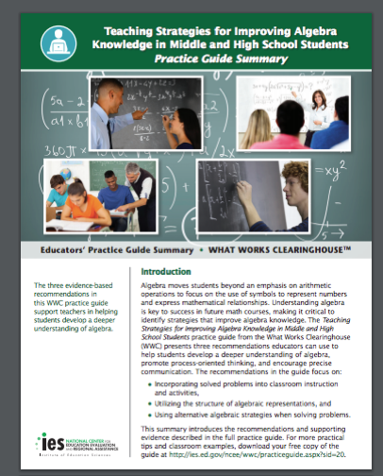
Teaching Strategies for Improving Algebra Knowledge in Middle and High School Students
Use solved problems to engage students in analyzing algebraic reasoning and strategies.
Teach students to use the structure of algebraic representations.
Teach students to intentionally choose from alternative algebraic strategies when solving problems.
(Star et al., 2015)
Notes:
The What Works Clearinghouse has reviewed research studies to identify specific evidence-based practices for mathematics. Although today’s focus is on the use of multiple representations, it is important to consider how to integrate it or include alongside other practices.

Slide 18
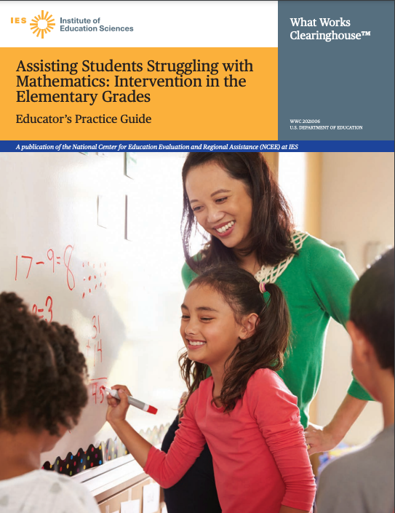
Assisting Students Struggling With Mathematics: Intervention in the Elementary Grades
Provide systemic instruction.
Teach clear and concise mathematical language.
Use a well-chosen set of concrete and semi-concrete representations.
Use number lines to facilitate learning.
Provide deliberate instruction on word problems.
Regularly include timed activities to build fluency.
(Fuchs et al., 2021)
Notes:
This practice guide was recently updated from a previous guide that focused on response to intervention. Although today we are focusing on middle school students, it is important to consider these practices, even though the title is elementary. The Institute of Education Sciences has strict guidelines for inclusion and in mathematics, middle school–focused research is behind. If you were to dig into the previous practice guide, much of what is listed here should be part of secondary mathematics instruction. In addition, many students with disabilities and those who struggle will need support in earlier grade-level skills.

Slide 19
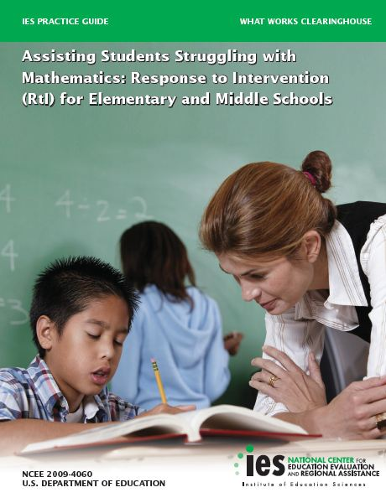
Assisting Students Struggling With Mathematics: Response to Intervention for Elementary and Middle Schools
Materials for intervention should focus on
whole numbers (kindergarten–grade 5) and
rational numbers (grade 4–8).
Instruction should be explicit and systematic.
Instruction on solving word problems is based on common underlying structures.
Students need opportunities to work with concrete materials and visual representations.
Intervention should include ≈10 minutes of fact instruction and practice in each session.
Monitor the progress of students.
Include motivational strategies.
(Gersten et al., 2009)
Notes:
This was the previous practice guide. Although it is 12 years older (2009), the practices are still relevant and should be considered in planning. You will see multiple representations listed here, just as in the more current practice guide.

Slide 20
Focus: Multiple Representations in Mathematics

Slide 21
Activity: Step One
Take out a piece of paper.
Take 1 minute to write down all the characteristics of a banana!
Notes:
[Read slide. This activity will span across the next few slides to show the importance of multiple representations. You will need a real banana, but it can be any fruit.]

Slide 22
Activity: Step Two
Now you will see a banana.
For 1–2 minutes,
add to your list and
revise your list.
After 1–2 minutes,
How did your list change?
Were the characteristics of a banana different once you saw a banana versus when just thinking about a banana? How?
Notes:
[Read slide. Hold up a banana that is similar to the picture on the next slide. Set timer for 1–2 minutes. Click for discussion questions and have the group discuss.]

Slide 23
Activity: Step Three
Now you will see a picture of a banana.
For 1–2 minutes,
add to your list and
revise your list.
After the 1–2 minutes,
how did you list change?
were the characteristics of a banana different once you saw a banana versus when just thinking about a banana? How?
Notes:
[Click for picture of banana. After 1–2 minutes, click for discussion questions.] This activity shows that we can create a better or more efficient list of characteristics of a banana when we looked at a picture and when we looked at a real banana. Mathematics is kind of like this, too! We often teach students a process or procedure abstractly. Many of us knew what a banana was, so making our initial list was easy, but what if I asked you to do the same thing with a lychee or rambutan? Would you have been able to even start a list prior to seeing this fruit? Some students, especially those who struggle, lack the prerequisite knowledge to connect to other mathematics skills. Hence, the importance of presenting mathematics with pictures and/or concrete materials alongside abstract representations.

Slide 24
Multiple Representations
C-R-A
Concrete
Representational/pictorial/virtual
Abstract
Does not always need to start with concrete; it is not linear but rather focused on building conceptual understanding.
Allows students to develop generalizations or rules, without the teacher simply telling or showing procedures alone.
C-R-A is a key piece of instruction often not included as part of mathematics instruction.
(Fuchs et al., 2021; National Council of Teachers of Mathematics, 2014; Witzel, 2016)
Notes:
[Read slide.]

Slide 25
Representations: Mental Residue
(Bush, Karp, & Doughtery, 2021)
Notes:
When thinking about including multiple representations or C-R-A, teachers need to think about the sweet spot. That is, teachers need to understand when and how to incorporate different representations that make sense to develop student learning while also considering how to use the representations to increase communication and mathematical precise language and discourse. This process often can be challenging because it is not a linear process, nor does every skill require all three representations.

Slide 26
Self-Reflection: Multiple Representations
How often do you include concrete or pictorial representations in your instruction?
Do you have particular skills that make you feel more confident in teaching with multiple representations?
What supports do you feel you need to better integrate multiple representations into your instruction?
Notes:
[Have participants begin by thinking about their responses; share with a peer and then lead a group discussion.]

Slide 27
Let’s Try!
Before you solve, consider this problem from NAEP.
Why might students struggle to solve it?
What prerequisite skills are needed to understand the problem and to solve?
(National Assessment of Educational Progress, 2013, Grade 4)
Notes:
[First have participants discuss the questions. Then have them solve and share their answers. If space allows, have participants show how they solved the problem and ask for examples that show different ways to solve.]
How did you solve? How many of you simply did an equation or procedure? How would you use a concrete image or pictorial to explain and solve this problem?
Content Classifications: Number properties and operations, Moderate, Type: SCR, Difficulty Level: Hard

Slide 28
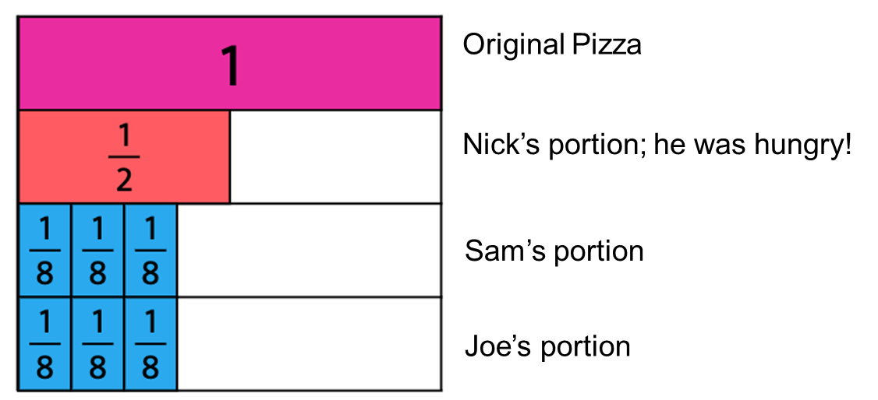
Talk It Out
Consider how you could use fraction bars to show how Nick could share.
First, you could show how the pizza would be shared based on the problem:
Notes:
[Read slide. Click for animation.] Many students may first start showing the problem like this, but does this answer the question? [Click for animation.] What misconceptions does this show in students’ understanding of the problem or of fractions?

Slide 29
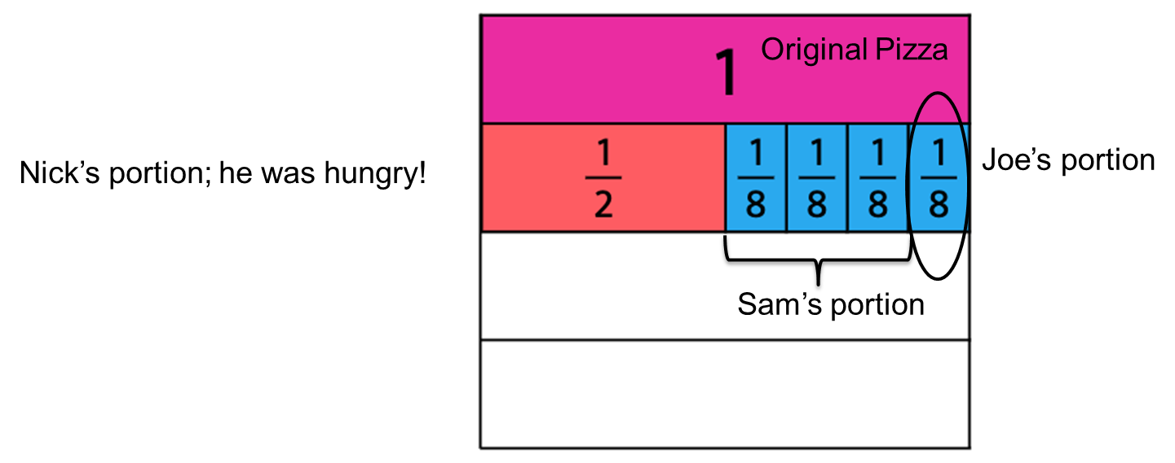
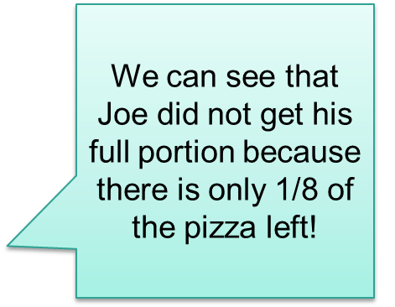
Talk It Out: Answering the Question
We can still use fraction bars and show that yes, I could create rows for each person, but that doesn’t show how much of the pizza is left. What do you notice about this picture?
Notes:
[Click for animation.] In this example, we moved the fraction tiles underneath the pizza or the whole. What do you notice now? How is this a more sophisticated way of solving? What are other ways to solve using fraction tiles?
This was a grade 4 problem, but 80 percent of the students did not solve it correctly. This is a great example of students not having a conceptual understanding of fractions and how to compare fractions. How often do you see the lack of conceptual understanding of fractions with students in middle school?

Slide 30
Importance of Multiple Representations: Try It Out
First, let’s discuss
What are some common misconceptions or lack of understanding of fractions that are evident in middle school students?
What about students who struggle or those in special education—do they struggle more, less, the same?
Now, let’s try it: Model the following fractions three different ways:
Notes:
[Read questions and discuss. Click for animations. Then, individually or in small groups. have participants model the fractions three different ways; provide fraction bars, if possible. After a few minutes, have participants share the different ways they modeled the fractions.]

Slide 31
Let’s Discuss
How often are you using concrete tools when teaching fractions? Ratios? Proportions?
How can using concrete manipulatives and a pictorial help increase students’ conceptual understanding of fractions?
How do we link concrete and pictorial representations of fractions to number lines?
Notes:
[Read and discuss questions.]

Slide 32
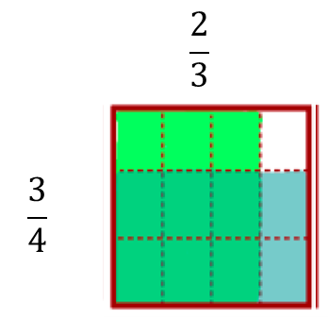
From Single Fractions to Computations
Model:
$\frac{1}{2}$ + $\frac{3}{7}$ =
$\frac{2}{3}$ $×$ $\frac{3}{4}$
+
Notes:
As middle school teachers, we often assume that students have a basic understanding of fractions, including computations. Although students may be able solve, many students, especially those who struggle and/or are in special education, cannot explain how to solve. Students often lack the conceptual understanding to explain or show how to solve. Consider these two basic computations, addition and multiplication. How do we model these two problems so that students develop the procedure, rather than you as a teacher explaining the procedure?
[Hit animation for original addition model: To model the addition of fractions using area models, you would first create two area models, identifying that you need a common denominator because you cannot add with different labels, for example 3 grapes + 2 pears = ? You need a common name, so you could change the labels to 3 pieces of fruit + 2 pieces of fruit = 5 pieces of fruit. What is a common name for one half plus three sevenths? Students should answer fourteenths. You could then divide the area models into fourteenths to show that one half is equivalent to seven fourteenths and three-sevenths is equivalent to six fourteenths.]
[Click for animations for the multiplication model. Multiplication is modeled similarly to addition, except it is on the same whole. Model the first fraction horizontally or vertically. Click for animation. Now model the next fraction. Click for animation. How many total pieces are now part of this whole? (12) How many of the 12 pieces are colored by both the green and the blue? (6) The answer is six twelfths.]

Slide 33
From Fractions to Ratios and Rates
Read the problem on the next slide.
Why might students struggle to solve this problem?
What are some common misconceptions that could hinder students’ solving?
After discussing, solve using a model, rather than the traditional algorithm.
Notes:
[Have participants solve and then discuss.]

Slide 34
Making Muffins
Travis attempted to make muffins to take to a neighbor who just moved in down the street. The recipe that he used required 2 cups of sugar and a cup of butter.
Travis accidentally put 2 cups of butter in the mix. What amount of sugar does Travis need to put into the mix to have the same ratio of sugar to butter that the original recipe calls for? Explain and show how.
Notes:
[Word problem created by research team.]

Slide 35
Linking Mathematical Skills
Students who struggle often lack the prerequisite skills necessary for building on and developing conceptual understanding of more advanced and grade-level material.
Consider the skills needed for expressions and equations in middle school.
What are the prerequisite skills needed to build greater understanding?
What are the key vocabulary words needed to increase understanding?
Notes:
[Read slide. Put participants in grade-level teams to discuss and complete the next exercise.]

Slide 36
Understanding Balancing Equations
How do we typically introduce expressions and equations?
How do we expect students to solve this equation: 3 + x = 9
Solve this equation two different ways.
Notes:
[Read the question. Have participants discuss. Think about this simple equation. Often, teachers jump directly to the procedure, subtract 3 from both sides and x equals 6. What are two different ways to solve for x?]

Slide 37
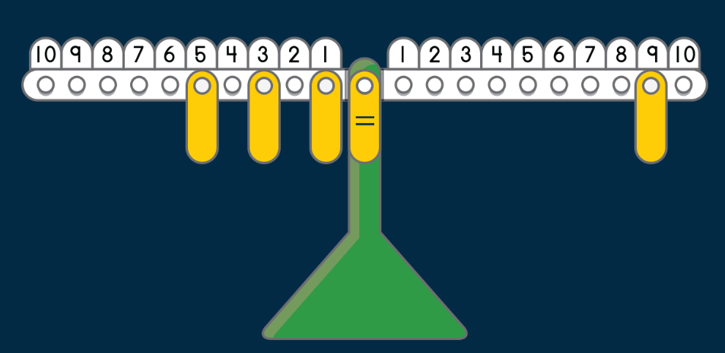
Making Equations Concrete
How does a misconception or lack of understanding of “equals” hinder understanding of balancing equations?
How can an actual balance, such as this virtual one, help show that equal means the same as? How can you use it to teach balancing equations?
https://www.didax.com/apps/math-balance/
Notes:
When you ask students what does “equal” mean, what do most students respond? Most students respond with that equal means the “answer,” not ”the same as.” This hinders their understanding of balancing equations, solving for a variable because they are so used to simply finding the answer. Think about the last equation we solved. Was that problem very different from what students see as early as grade 1? Rather than a variable, students have to find the missing number for a box. Rather than rely on a procedure, they rely on their knowledge of 3 plus 6 equals 9. Unfortunately, in middle school, we jump quickly to a procedure and do not develop or remind them that equal means the same as, so we also can just think about three plus something equals 9, or in this example CLICK FOR ANIMATION we show that 5 + 3 + 1 is the same as 9. How could you use a virtual balance or borrow a balance from the science room to show the process for solving for variables?

Slide 38
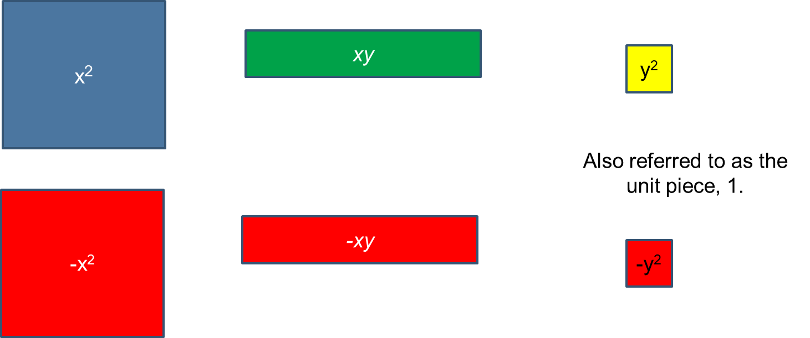
Using Algebra Tiles to Illustrate Expressions and Equations
(Balka & Boswell, 2017)
Notes:
In addition to a balance, we also can consider the use of algebra tiles for more complex equations and polynomials. How many are familiar with algebra tiles? How many of you use them to illustrate expressions and equations?

Slide 39
Modeling With Tiles
What polynomials are represented?
Notes:
Answers:
1. 2x² + (-2xy) + y²
2. x² + 3xy + 5y²

Slide 40
Practice
Solve. Be prepared to share your thinking and how you solved.
Jessica makes clay bowls. The following equation relates the number of clay bowls, n, she makes and the total amount of money, d, in dollars, it costs her to make them.
d = 375 + 50n
Based on the equation, which of the following statements is true?
Without making any clay bowls, Jessica’s total cost is $50.
Without making any clay bowls, Jessica’s total cost is $375.
Each clay bowl that Jessica makes decreases her total cost by $50.
Each clay bowl that Jessica makes increases her total cost by $375.
Each clay bowl that Jessica makes costs $425.
Notes:
[NAEP, grade 8, year 2017, Algebra, difficulty level: medium]
How did you solve? What do you think is the percentage of eighth-grade students who correctly solved this problem? Only 36 percent of students correctly identified B as the correct answer. Many students (17 percent) selected C, with 16 percent selecting D, 16 percent selecting E, and 12 percent selecting A. Why do you think this problem is so challenging? How can using manipulatives, such as algebra tiles or pictures, help increase conceptual understanding for students?

Slide 41
Putting It Together: Expressions and Equations Grade 6 Example
In grade-level teams,
review the standards for Expressions and Equations;
identify the key prerequisite skills needed; and
identify the standards that could benefit from the C-R-A approach to instruction.
Overarching standards (all have substandards)
apply and extend previous understandings of arithmetic to algebraic expressions;
reason about and solve one-variable equations and inequalities; and
represent and analyze quantitative relationships between dependent and independent variables.
Common Core State Standards: Mathematics
Notes:
[These are the main standards for expressions and equations from the Common Core State Standards for grade 6. Substitute your own standards as applicable. Use the sample worksheet as an example.]
First, review the standards and any possible student data, including universal screeners, state testing results, and in-class homework as applicable. Now identify what prerequisite skills are needed for students to be successful. Identify standards and specific activities that incorporate concrete-pictorial-abstract.

Slide 42
Instructional Planning and Scaffolding
Supporting Students Who Struggle

Slide 43
Supporting Students Who Struggle
Students who struggle often will need scaffolds and may need concrete or pictorial representations longer than peers.
The types of scaffolds include multiple means of
engagement (the why of learning);
representations (the what of learning); and
action and expression (the how of learning).
Notes:
[Read slide.]

Slide 44
Types of Scaffolds
Teacher and Peer Scaffolds: Increase support when new concepts are introduced. Gradually fade support.
Content Scaffolds: Easier concepts or skills are introduced first. Consider the use of mathematical trajectories to target prerequisite skills.
Task Scaffolds: Build from easier to more difficult tasks or add concrete materials or visuals to decrease the difficulty level.
Material scaffolding: Offer a variety of materials to support student thinking.
Notes:
Let’s discuss specific scaffolds to support students with mathematical difficulty, as well as all students. In small groups, brainstorm specific ways of how to apply these scaffolds to your teaching.
[Share out with the group. The following are some examples of why and how these scaffolds are key to meeting the needs of all learners:
Teacher and peer standards:
Identify type of support and plan to fade as needed.
Content scaffolds:
Addresses prerequisite skills.
Previews new skills.
Task scaffolds
Teaches student to ask and answer questions.
Applies cognitive strategy instruction.
Reduces the step size, or jump from one idea to the next, for the learner.
Alerts the learner that the instruction is moving to a new idea.
Material scaffolds:
Moves instructional conversation from teacher-student to student-student.
Presses student for explanation.
Asks follow-up questions that help provide continuity and extend the discussion.]

Slide 45
Mathematics-Specific Evidence-Based Practices
(Fuchs et al., 2021)
Notes:
Evidence-based practices are proven instructional strategies that have led to increased student understanding and outcomes. We reviewed a few of these practices at the beginning of our session and are bringing them back in now to think about how we can use these specific practices to support students who struggle.

Slide 46
Connection Between Scaffolds and Evidence-Based Practices
Scaffolding and embedding evidence-based practices should be included in the lesson plan, rather than reactive during the lesson.
Teachers should review data to determine what scaffolds students need and pair them with instructional strategies to increase conceptual understanding.
General and special educators collaborate so that SDI is part of each lesson, alongside scaffolds.
Notes:
[Read slide.]

Slide 47
Trajectories, Scaffolds, and Lesson Planning
First, divide into teams that include one person from each grade level.
Second, examine and compare the mathematical trajectories in expression and equations.
How are skills linked?
How are the skills taught across grade levels?
Are there missing connections?
Third, complete a lesson plan that includes
grade-level skills with connection to the previous and the next grade level;
explicitly identifying how multiple representations will be included;
identifying possible misconceptions and scaffolds; and
a common assessment that varies slightly for each grade level but can be compared to identify strengths and areas of improvement within and across the skill.
Notes:
[Give participants time to complete a lesson plan. Include a postassessment that would measure the skills across the grade levels to discuss at a later time.]

Slide 48
Lesson Components
Think about the following questions as you plan your lesson:
What are common misconceptions?
What concrete/pictorial example(s) can be modeled?
What can I do if some students do not understand the concept?
How can I check for understanding?
Notes:
[Read slide.]

Slide 49
Closing

Slide 50
In Closing
The use of multiple representations or the C-R-A approach has been shown to be highly effective as an evidence-based practice.
It should be an integral part of every unit, especially in middle school.
It supports conceptual understanding, specifically for computational skills for students with mathematical difficulty and multilingual learners.
Instructional lesson planning should use multiple representations to link prerequisite skills and as a scaffold to increase understanding and mathematical discourse
(Bouck et al., 2018; Fuchs et al., 2021; Molina, 2012)
Notes:
[Read slide.]

Slide 51
Resources and References

Slide 52
Resources
Math tasks and word problems
COHERENCE MAP
NAEP QUESTIONS TOOL
Smarter Balanced Assessment Consortium (SBAC) SAMPLE QUESTION LINK
Virtual math manipulatives
Various math manipulatives from Didax (all free)
Fraction Manipulatives: Toy Theater
National Library of Virtual Manipulatives
Notes:
Many questions that were included are available for free within the coherence map, the NAEP questions tool, and the SBAC sample question bank.

Slide 53
References
Balka, D., & Boswell, L. (2017). Working With Algebra Tiles (2nd ed.). Didax.
Bouck, E., Satsangi, R., & Park, J. (2018). The Concrete-Representational-Abstract Approach for Students With Learning Disabilities: An Evidence-Based Practice Synthesis. Remedial and Special Education, 39(4): 211-228. https://doi.org/10.1177/0741932517721712
Bush, S., Karp, K., & Dougherty, B. (2021). The Math Pact: Achieving Instructional Coherence Within and Across Grades in Middle School. Corwin Press.
Fuchs, L. S., Bucka, N., Clarke, B., Dougherty, B., Jordan, N. C., Karp, K. S., Woodward, J., Jayanthi, M., Gersten, R., Newman-Gonchar, R., Schumacher, R., Haymond, K., Lyskawa, J., Keating, B., & Morgan, S. (2021). Assisting Students Struggling With Mathematics: Intervention in the Elementary Grades (WWC 2021006). Washington, DC: U.S. Department of Education, Institute of Education Sciences, National Center for Education Evaluation and Regional Assistance. Retrieved August 24, 2022, from https://ies.ed.gov/ncee/wwc/Docs/PracticeGuide/WWC2021006-Math-PG.pdf.
Gersten, R., Beckmann, S., Clarke, B., Foegen, A., Marsh, L., Star, J. R., Witzel, B., Dimino, J., Jayanthia, M., Newman-Gonchar, R., Monahan, S., & Scott, L. (2009). Assisting Students Struggling With Mathematics: Response to Intervention (RtI) for Elementary and Middle Schools (NCEE 2009-4060). Washington, DC: U.S. Department of Education, Institute of Education Sciences, National Center for Education Evaluation and Regional Assistance. Retrieved August 24, 2022, from https://ies.ed.gov/ncee/wwc/Docs/PracticeGuide/rti_math_pg_042109.pdf.

Slide 54
References (continued)
National Council of Teachers of Mathematics. (2014). Principles to Actions. Ensuring Mathematical Success for All. Reston, VA: Author.
National Governors Association Center for Best Practices & Council of Chief State School Officers. (2010). Common Core State Standards: Mathematics. Washington, DC: Author.
Molina, C. (2012). The Problem With Math Is English. Jossey-Bass.
PROGRESS Center. (2021). IEP Tip Sheets. Retrieved August 24, 2022, from https://promotingprogress.org/resources/iep-tip-sheet-series.
The IRIS Center. (2014). Evidence-Based Practices (Part 1): Identifying and Selecting a Practice or Program. Nashville, TN: Author. Retrieved August 24, 2022, from https://iris.peabody.vanderbilt.edu/module/ebp_01/.
Star, J. R., Foegen, A., Larson, M. R., McCallum, W. G., Porath, J., & Zbiek, R. M., Caronongan, P., Furgeson, J., Keating, B.,& Lyskawa, J. (2015). Teaching Strategies for Improving Algebra Knowledge in Middle and High School Students (NCEE 2015-4010). Washington, DC: U.S. Department of Education, Institute of Education Sciences, National Center for Education Evaluation and Regional Assistance. Retrieved August 24, 2022, from https://ies.ed.gov/ncee/wwc/docs/practiceguide/wwc_algebra_040715.pdf.

Slide 55
Disclaimer
This content was produced under U.S. Department of Education, Office of Special Education Programs, Award No. H326M17002. Christina Diamond serves as the project officer. The views expressed herein do not necessarily represent the positions or polices of the U.S. Department of Education. No official endorsement by the U.S. Department of Education of any product, commodity, service, or enterprise mentioned in this website is intended or should be inferred.

