Slide 1
Increasing Student Engagement and Discourse for Students With Mathematics Difficulties and Disabilities
Expanding Middle School Students’ Understanding of Algebraic Reasoning for Students With Disabilities
American Institutes for Research
Notes:
The purpose of this module is to focus on the importance of asking higher level, inquiry-based questions that lead to increased student discussion, student talking, and overall discourse in middle school mathematics classes. Student discourse leads to greater student engagement and conceptual understanding but is often limited in middle school mathematics classrooms. Additionally, many students who struggle or students with disabilities often lack the prerequisite skills, vocabulary, and working memory to actively engage. The limited engagement can further widen the academic gap. This module is designed to be completed during a full-day professional development, or it may be broken into smaller chunks. The mathematics problems are designed to be completed with partners or in small groups and then discussed with the larger group.
The handout includes background information, graphs to analyze, vocabulary tables, and student case studies.
Instructions for using the speaker notes
• Text formatted in standard font is intended to be read aloud or paraphrased by the facilitator.
• Text formatted in italics is intended as directions or notes for the facilitator; italicized text is not meant to be read aloud.
Welcome participants to the training. Introduce yourself (or yourselves) as the facilitator(s) and briefly cite your professional experience in regard to mathematics instruction and supporting students who struggle and students with disabilities in mathematics.
Although permission to reprint this publication is not necessary, the citation should be as follows: American Institutes for Research. (2022). Increasing student engagement and discourse for students with mathematics difficulties and disabilities: Expanding middle school students’ understanding of algebraic reasoning for students with disabilities. Office of Special Education Programs, U.S. Department of Education.

Slide 2
Objectives
Participants will
understand national trends in mathematics,
understand the learning gaps that exist in middle school,
define and increase mathematics discourse, and
identify math tasks and instructional practices that lead to high student engagement.
Notes:
[Read slide.] This is a suggested agenda and can be altered to fit your needs.

Slide 3
Start With the Why
Take out five sticky notes.
Why do students struggle in math?
Write one response on each sticky note.
Notes:
[This is a 5 by 3 root cause analysis. This will be repeated three times. After the first set of bullets, click for animation. This will ask participants to take out another five sticky notes. They will need a total of 15 sticky notes.]

Slide 4
Start With the Why (Step 2)
Take out five more sticky notes.
Why do students struggle in math?
Write five more responses, one response per note.
Notes:
[This is a 5 by 3 root cause analysis. This will be repeated three times. After the first set of bullets, click for animation. This will ask participants to take out another five sticky notes. They will need a total of 15 sticky notes.]

Slide 5
Start With the Why (Step 3)
Take out five more sticky notes.
Why do students struggle in math?
Write five more responses, one response per note.
Notes:
[This is a 5 by 3 root cause analysis. This will be repeated three times. After the first set of bullets, click for animation. This will ask participants to take out another five sticky notes. They will need a total of 15 sticky notes.]

Slide 6
Why: Sort
First, review your 15 responses and sort them into categories.
Second, combine your responses and categories with your table partners.
Lastly, combine all categories and responses of the group.
Complete a gallery walk to examine the responses and categories.
What do you notice?
Any surprises in the categories and/or responses?
Notes:
[Read slide and click for animations. The purpose of this activity is to get to the true root cause of why students struggle, moving beyond the typical responses of kids who are not motivated, are tired, and so forth. The goal is for participants to identify more instructional challenges, misconceptions, and lack of conceptual understanding.]

Slide 7
Why: Sort (Step 2)
Second, combine your responses and categories with your table partners.
Notes:
[Read slide and click for animations. The purpose of this activity is to get to the true root cause of why students struggle, moving beyond the typical responses of kids who are not motivated, are tired, and so forth. The goal is for participants to identify more instructional challenges, misconceptions, and lack of conceptual understanding.]

Slide 8
Why: Sort (Step 3)
Complete a gallery walk to examine the responses and categories.
What do you notice?
Any surprises in the categories and/or responses?
Notes:
[Read slide and click for animations. The purpose of this activity is to get to the true root cause of why students struggle, moving beyond the typical responses of kids who are not motivated, are tired, and so forth. The goal is for participants to identify more instructional challenges, misconceptions, and lack of conceptual understanding.]

Slide 9
National Trends in Mathematics
Notes:
[Read slide.]

Slide 10
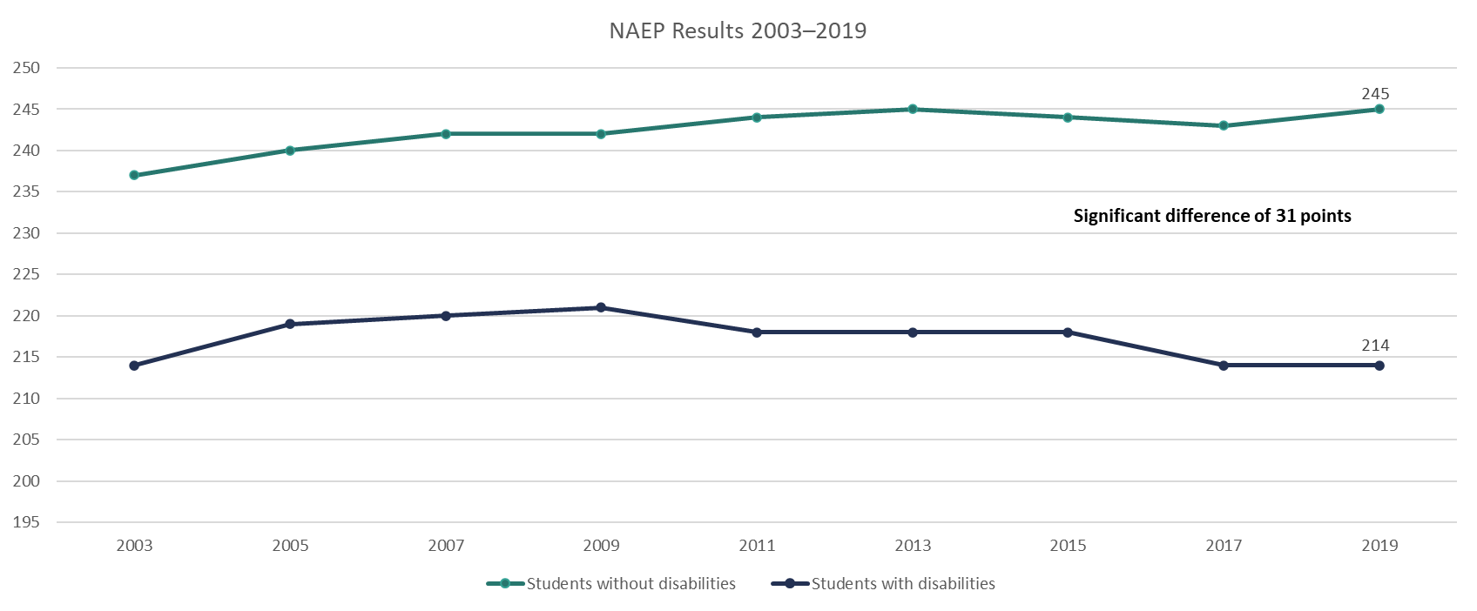
National Mathematics Trends: National Assessment of Educational Progress (NAEP) Grade 4
Notes:
As you can see, between 2003 and 2019, a significant gap exists between scores of fourth-grade students with and without disabilities on the NAEP. This is a gap that has not decreased over time and, in fact, has increased. These results are for Grade 4, but how might these gaps in skills impact students in middle school? Additionally, early data are showing the effect of COVID and, for the first time, an even larger decrease in scores for all students, but especially for students with disabilities.

Slide 11
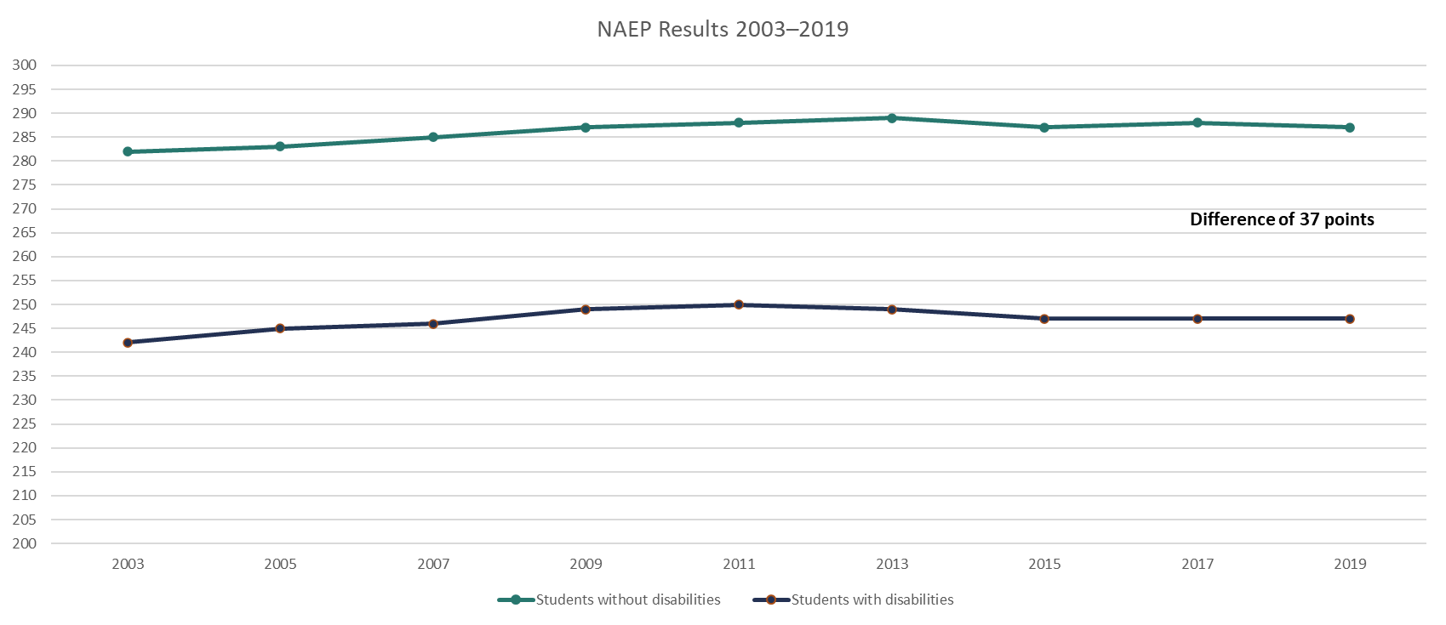
National Mathematics Trends: NAEP Grade 8
Notes:
From Grade 4 to Grade 8, we do not see much difference, meaning the gap between students with disabilities and students without disabilities is not closing.

Slide 12
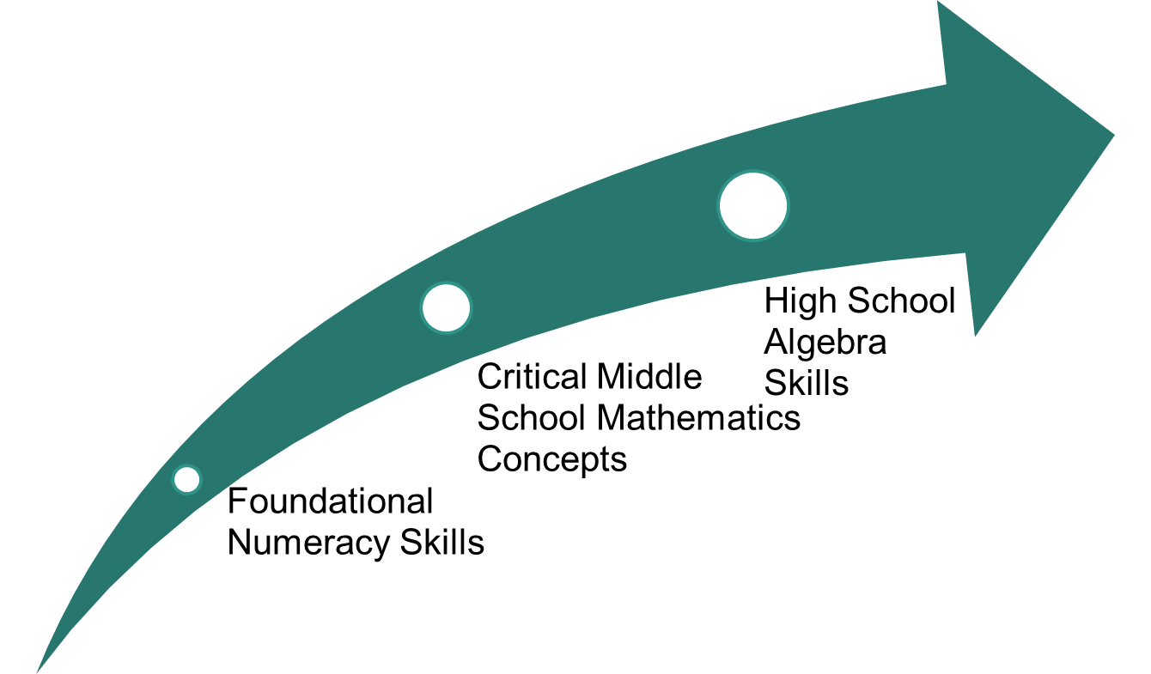
Developing Foundations of Algebra
Notes:
Mathematics is an area in which the skills are highly interconnected, and, when students do not fully develop the foundational skills in elementary school, their learning becomes filled with misconceptions, or they lack conceptual understanding. As mathematics becomes more challenging, the holes and misconceptions in student understanding affect concept development in middle school, which can hinder student understanding of algebraic concepts in high school. This situation becomes a problem because algebra is considered the gateway to other mathematics classes and is often the prerequisite for many postsecondary classes.

Slide 13
Interconnectedness of Mathematics
Mathematical standards are not stand-alone skills.
They build upon standards within the same grade level.
They build upon standards across grade levels.
As students get older, the gaps within and across grade levels increase, leading to
less conceptual understanding,
development of misconceptions, and
greater need for intervention support.
Notes:
As indicated on the previous slide, many students with mathematics difficulties develop gaps in learning and misconceptions that hinder conceptual understanding. We often see greater skill gaps in middle school when standards tend to be more difficult and are connected to previous standards and students show an inability to generalize previous skills to more demanding tasks.

Slide 14
Importance of Prerequisite Skills
Iceberg Problem
Notes:
[Following the explanation of the Iceberg Problem, there is an activity. Participants will need three different-colored dots or sticky notes. Chart paper that lists the insights or copy of Slides 14, 15, and 16 should be hung in the room. The activity is on Slide 17.]

Slide 15
Iceberg Problem: Unfinished Learning
Students with disabilities and other students with mathematics difficulties often have unfinished learning.
Teachers may feel pressure to focus solely on grade-level standards and scope and sequence and not address the gaps. This may result in greater gaps between peers without mathematics challenges and peers without disabilities, as identified in the NAEP scores.
Notes:
[Read slide.]

Slide 16
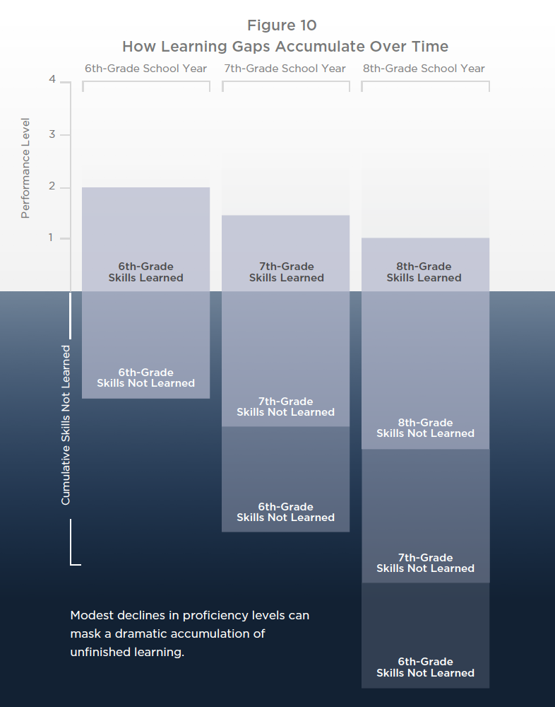
Iceberg Problem
Unfinished learning accumulates “below the surface,” similar to an iceberg.
The learning that is considered mastered is the part we see—the top of the iceberg.
How do these learning gaps relate to our root cause of why students struggle?
Notes:
[Read slide.]

Slide 17
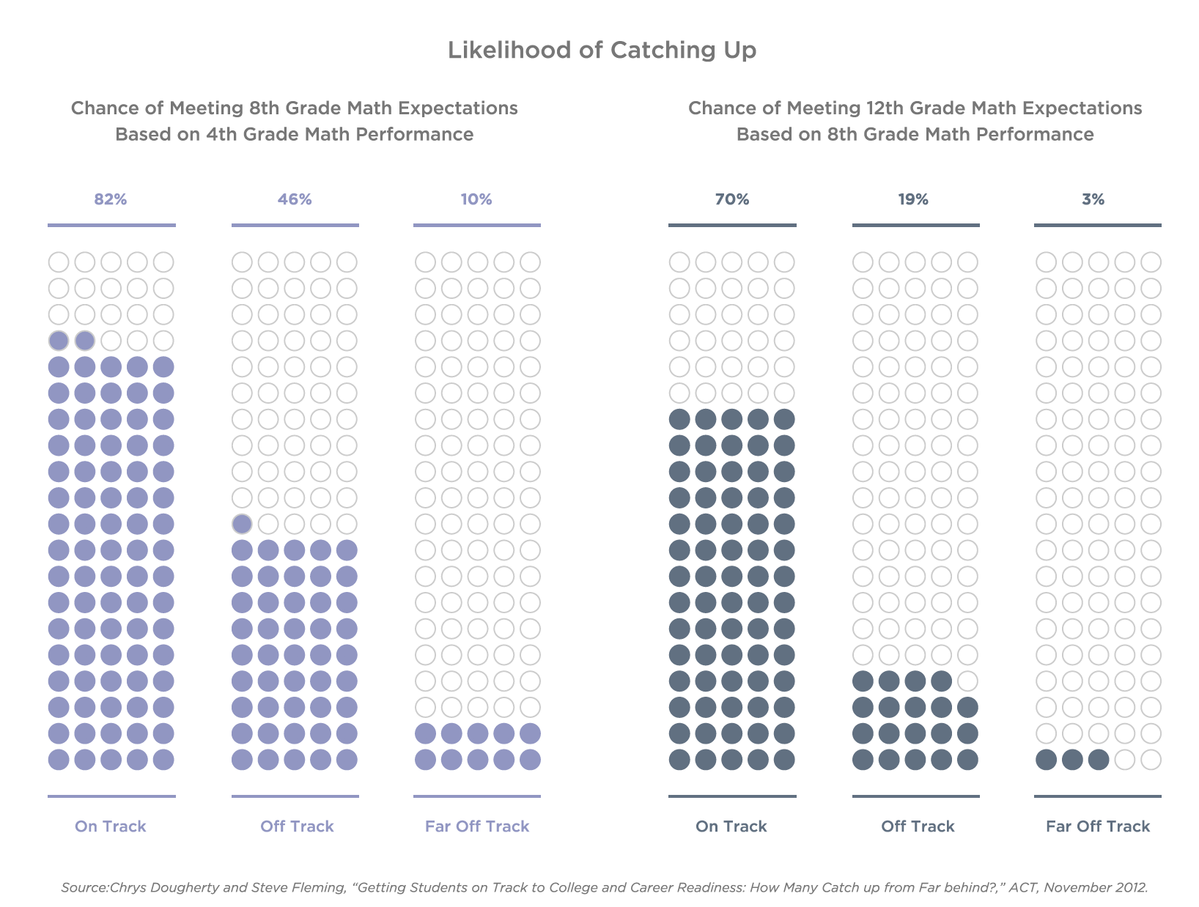
Iceberg Problem: How Assessment and Accountability Policies Contribute to Learning Gaps in Mathematics Persisting Below the Surface
https://newclassrooms.org/icebergproblem/
Notes:
Longitudinal studies of individual students over time can show more precisely how students who fall behind are likely to stay behind. For example, Figure 8 shows some of the findings from a 2012 study conducted by ACT.⁸ Researchers tracked results from tens of thousands of students, one group from 4th grade to 8th grade, and another from 8th grade to 12th grade. In both groups, the vast majority of students who started out behind in mathematics stayed behind. Chances of catching up were even worse in the upper grades: A student who was “far off track” in eighth grade mathematics had only a 3% chance of reaching college readiness standard mastery by the end of high school.⁹ This same study also found that students in the “far off track” group were much more likely to attend high-poverty schools.

Slide 18
Iceberg Report: Key Insight 1
Mathematics is cumulative—unfinished learning from prior years makes it harder for students to master more advanced concepts.
Achieving grade-level proficiency requires filling pre-grade gaps and mastering grade-level material.
Many middle school mathematics teachers have too little time in a single year to both cover grade-level material and address students’ unfinished learning from prior years.
Teachers feel the tension between grade-level instruction and individual student needs and need to find the “sweet” spot between not too hard and not too easy.
Failing to adequately address unfinished learning in middle school has long-term consequences.
https://newclassrooms.org/icebergproblem/
Notes:
[Read slide.]

Slide 19
Iceberg Report: Key Insight 2
Current educational policies favoring grade-level instruction are hindering many students’ long-term success.
Summative assessments are not structured to measure the full range of learning growth.
Accountability systems are limited by the constraints of the underlying assessments.
Growth metrics used for accountability do not provide a full picture of student learning gains.
There are barriers to innovative assessment pilots yielding more comprehensive measures of growth.
Notes:
[Read slide.]

Slide 20
Iceberg Report: Key Insight 3
Balancing pre-grade-level, on-grade-level, and post-grade-level skills to each student’s needs can better support students’ long-term success.
Evidence is emerging on the relationship between student performance and the level of instructional content.
There is little evidence to suggest that, for students who are far below grade level, focusing instruction exclusively on grade-level content is effective.
A focus on learning growth can also motivate teachers and students to reach high expectations.
Notes:
[Read slide.]

Slide 21
Dot Chart
Consider your root causes and the Iceberg Report key insights.
Take three dots (or star stickers); green, yellow, and red to place on the key insights.
Green dot: I feel comfortable addressing this insight.
Yellow dot: I could use some support to address this insight.
Red dot: This is the most challenging insight for me to address in my teaching.
Notes:
[Give participants colored dots or star stickers. In this example green, yellow, and red are used, but it can be any three different colors or different shapes. Provide chart paper to record.]
[Read slide.]

Slide 22
Dot Analysis Discussion
Are you surprised by the Iceberg Problem or the key insights? Why?
How do you currently address some of the challenges (green and yellow dots) addressed within the key insights?
What makes the insight marked with a red dot so challenging? What support do you need to better address the challenges?
Notes:
[Facilitate discussion.]

Slide 23
Mathematics Brain!
Notes:
Before we dive into specific strategies to increase engagement of students, let’s get our brain going with a mathematics problem.

Slide 24
Warm-Up
Josh and Samantha are planning to have a new home built. First, they need to select one of the lots of land to purchase. Here are the available lots: ​
Lot 9: 250 feet by 258 feet​
Lot 13: 220 feet by 275 feet​
Lot 15: 240 feet by 260 feet​
Samantha would like the lot to be as square as possible. Which lot should they purchase? Explain your reasoning.
(SanGiovanni & Novak, 2018)
Notes:
[Read slide. Have participants work individually or in groups. Prior to sharing, discuss questions on next slide.]

Slide 25
Solving
What additional questions might students need, or how might students need support to solve?
How do you think your students would solve?
How did you solve? Did anyone solve differently?
How could you increase student engagement as part of this task?
Notes:
[Lead discussion and have participants share different ways to solve.]

Slide 26
Importance of Engagement
Instructional Strategies to Support Students Who Are Struggling

Slide 27
Let’s Chat: Engagement
How do we increase student engagement in mathematics classes for all students?
Why do students with disabilities and students at risk for mathematics difficulty struggle to engage in mathematics classes?
Notes:
[Read slide and facilitate discussion.]

Slide 28
Power of Engagement
Student engagement is more than just sitting in class. Student engagement includes the following:
Ability to express themselves emotionally in learning activities
Exhibiting active behavior such as raising their hand, making suggestions, participating in a group, or answering a question
Ability to process information and link to prior knowledge
Exhibiting emotional engagement that includes interest and enjoyment
(Schnitzler et al., 2020)
Notes:
[Read slide.] Engagement is more than simply making sure that students complete work. Engagement is dimensional, and full engagement is often not present for students with disabilities in core mathematics classes.

Slide 29
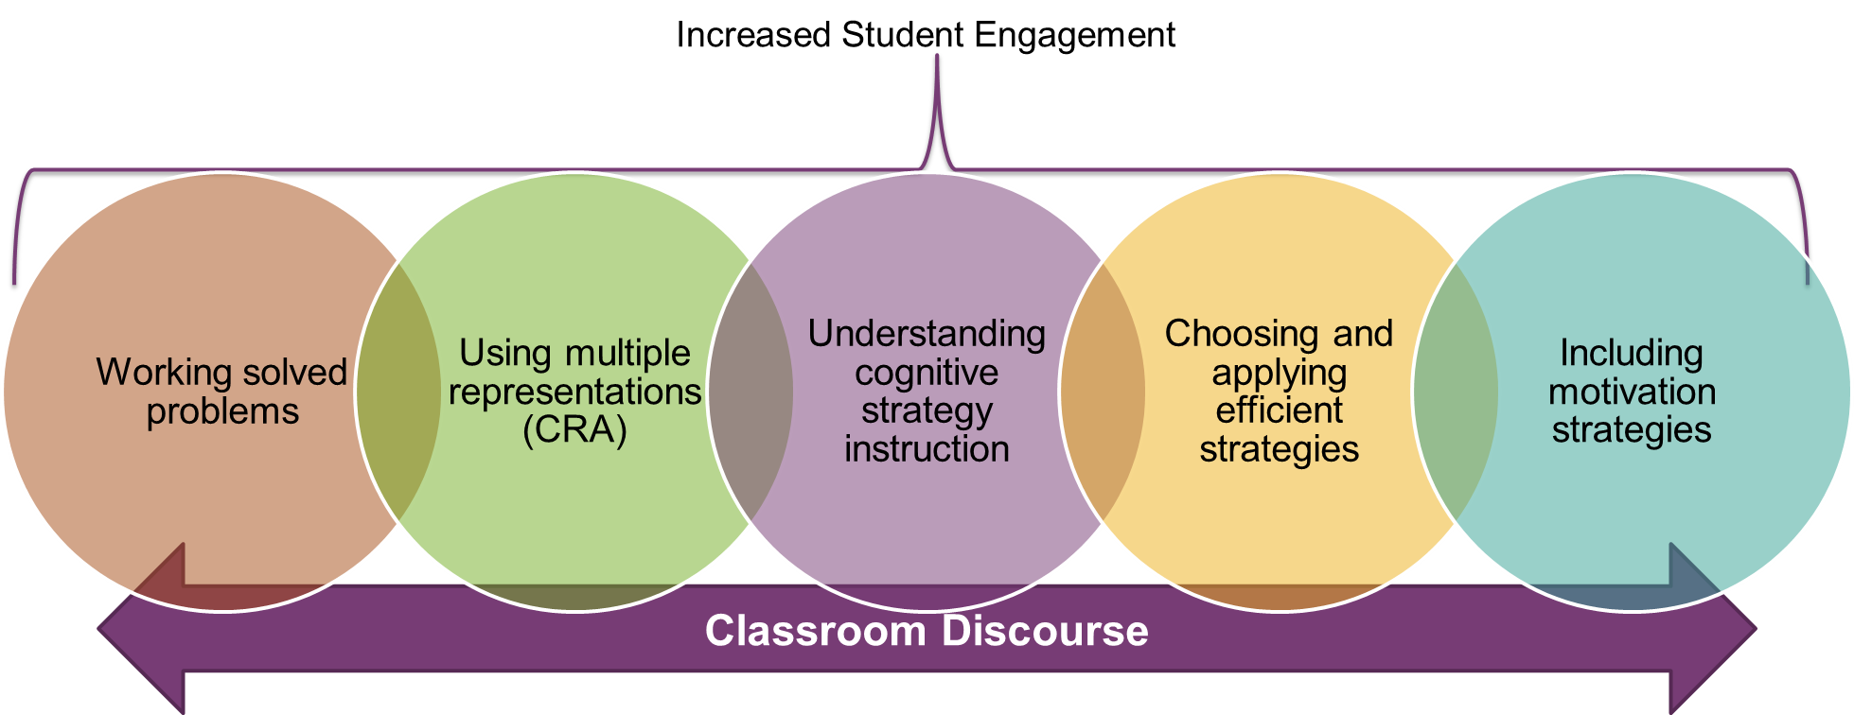
Mathematics Evidence-Based Practices
(Fuchs et al., 2021)
Notes:
What are mathematics evidence-based practices? We talk about discourse, but, for discourse to be evident in the classroom, we need to create a learning environment in which students feel and see success and are fully engaged! For students with mathematics difficulties, this means that teachers need to be intentional and purposeful in using evidence-based practices, such as working solved problems, using multiple representations often referred to as concrete-representational-abstract, explicitly teaching effective strategies and cognitive strategy instruction, and motivation strategies that can lead to increased self-regulation.
When students are successful and developing conceptual understanding, they are more likely to be engaged and have the skills to actively participate in classroom discussions. When this happens, a teacher is truly increasing classroom discourse.

Slide 30
Facilitating Meaningful Discourse and Engagement
Discourse includes purposeful discussion but also includes verbal, visual, and written communication.
Teachers need to consider the best way to include discourse that leads students to learn and know how to solve.
Students who struggle may need additional support, with the teacher considering the following:
Different ways to support students
Different types of questions or lower level questions prior to higher level questions
Assist students to provide explanations through sentence stems
Allow and encourage different representations, less focus on verbal (for example)
(Hufferd-Ackles et al., 2004; National Council of Teachers of Mathematics, 2014)

Slide 31
What Is Discourse?
Mathematical discourse is about whole-class and small-group discussions in which students talk about mathematics in such a way that they reveal their understanding of concepts.​
Discourse involves asking strategic questions that elicit from students both how a problem was solved and why a particular method was chosen, discussing whether the particular method chosen was valid and why this method works.​
Students learn to critique their own and others’ ideas and seek out efficient mathematical solutions.
(Herbel-Eisenmann & Otten, 2011; Simpson et al., 2015)
Notes:
[Read slide.]

Slide 32
Increasing Discourse: Intersection of High-Leverage Practices and Evidence-Based Practices
Notes:
The long-term goal for students is success in upper mathematics classes. Research has shown that discourse and engagement are key, but students can only be part of discourse when teachers provide instruction that supports students. This means that we need to think about the evidence-based practices, as well as the high-leverage practices or the instructional practices that lead to greater student engagement and conceptual understanding.

Slide 33
High-Leverage Practices
High-leverage practices are those practices that can be used to leverage student learning across different content areas, grade levels, and student abilities and disabilities.
High-leverage practices can be combined with evidence-based practices, such as the following:
Explicit instruction and vocabulary
Practice and multiple representations
High-leverage practices are a foundation of good teaching for both general and special educators.
(McLeskey et al., 2017)
Notes:
High-leverage practices are not all evidence based, meaning they were not tested to the same degree to determine effectiveness, but they are all research based. This means that there is research to support their use within classrooms to meet student needs. High-leverage practices are not just for mathematics classrooms; they are for all classrooms to build on the foundation of meeting students with disability needs.

Slide 34
High-Leverage Practices Specific to Promoting Engagement
Use flexible grouping.
Use strategies, such as the following, to promote active student engagement:
Choral response
Response cards, such as signal cards and/or whiteboards
Hand signals
Systematically design instruction toward a specific learning goal. See the following for examples:
Use warm-ups as data collection; set the stage.
Present information that encourages engagement.
Model for students in different ways.
Provide time for guided practice with scaffolds.
Provide time for independent practice with scaffolds.
Utilize a closing or exit ticket, such as:
Three-column charts: What I knew; What I now know; What I still don’t know or wish I knew
Notes:
[Read slide. Ask for additional strategies participants have utilized.]

Slide 35
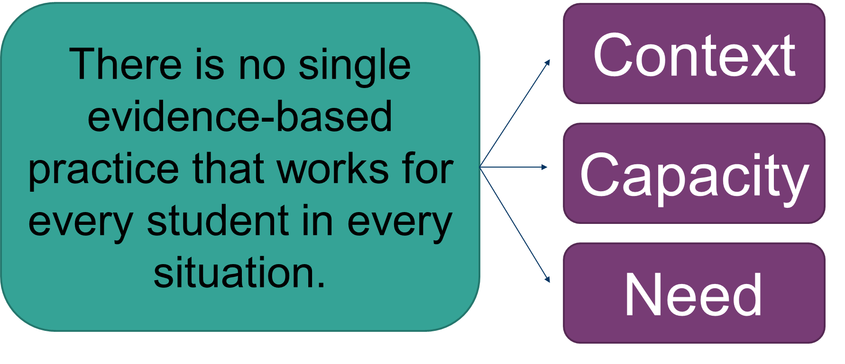
Current Reality
Notes:
Teachers need to consider context, capacity, and need. Teachers can insert evidence-based practices and high-leverage practices, but, if students are not engaged, then they are not learning and/or mastering the skills. It is imperative that in planning for instruction, we consider the needs of students before and during planning versus reactive during instruction.

Slide 36
Increasing Student Achievement and Engagement
Planning for Instruction

Slide 37
Challenges
What do you see as the greatest challenge?
Notes:
As we reviewed, all students, but especially students with disabilities and students who struggle, have huge gaps in their conceptual understanding of mathematics. This means that not only do teachers need to embed evidence-based practices, but they need high student engagement and discourse between and among students.
Click for animation.

Slide 38
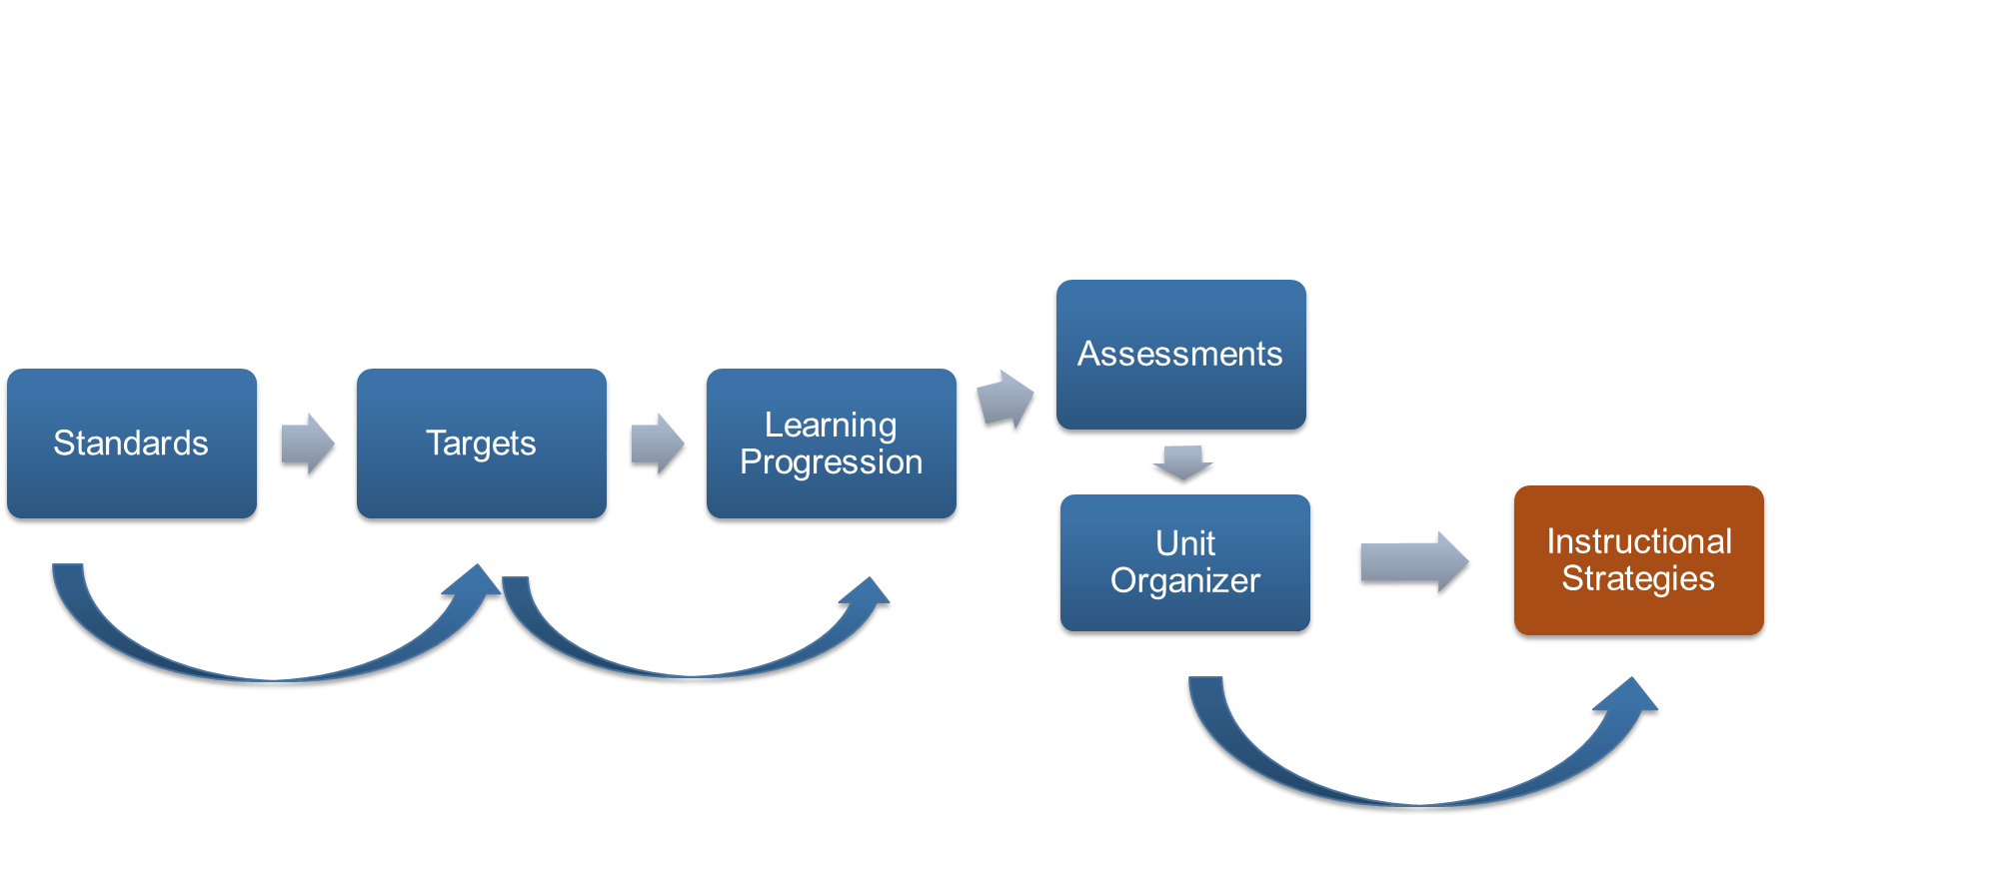
Planning for Instruction
Notes:
In thinking about engagement, we need to start at instruction. What are the standards, targets, and learning progressions? Where and how might students struggle? What may impact their engagement? How will I monitor student skills? Throughout the entire process, instructional strategies must be considered and explicitly placed within lesson plans.

Slide 39
Determine the Instructional Technique
Learn Critical Content
Identifying Critical Content
Previewing New Content
Organizing Students to Interact With Content
Helping Students Process Content
Helping Students Elaborate on Content
Helping Students Record and Represent Knowledge
Deepen Critical Content (Learning Goal Targets)
Managing Response Rates With Question Sequencing
Reviewing Content
Helping Students Practice Skills, Strategies, and Processes
Helping Students Examine Similarities and Differences
Helping Students Examine Their Reasoning
Helping Students Revise Knowledge
Utilize Critical Content
Investigating
Experimental Inquiry
Problem Solving
Decision Making
Notes:
In thinking about instructional practices, we need to align with the complexity of thinking. How can we help students to learn critical content? How do we go deeper into the learning targets and utilize critical content?

Slide 40
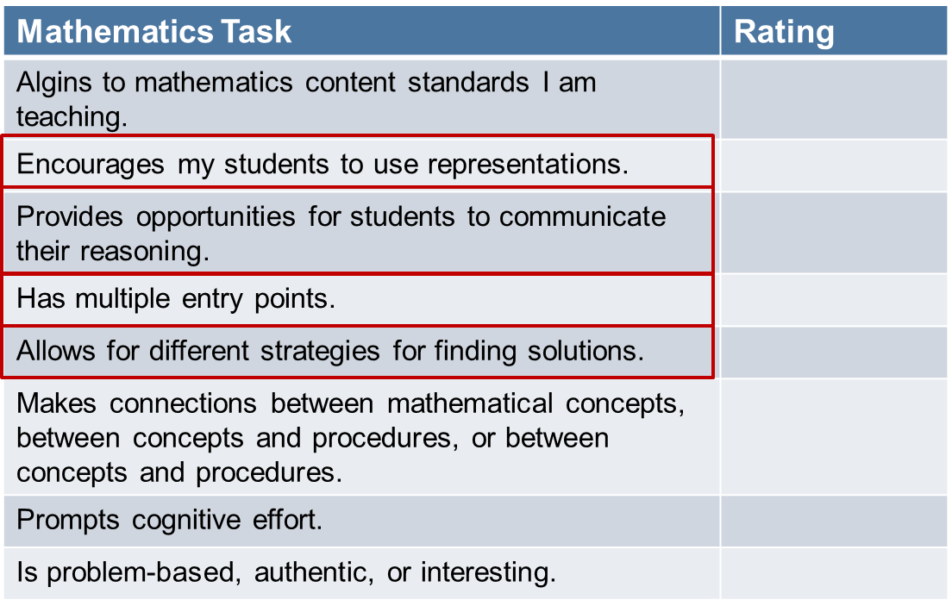
Reflect on Recent Lesson: Engagement
Handout
The purpose of the task is to teach or assess:
Conceptual understanding
Procedural skill and fluency
Application
Rating Scale:
2–Fully Meets the Characteristic
1–Partially Meets the Characteristic
0–Does Not Meet the Characteristic
Notes:
[Give each participant a paper version of this rubric and have them utilize it to review a current lesson after Slide 44.]
This is a rubric based upon the book Mine the Gap. When we think about engagement [click for animations], you will see these items align with mathematics evidence-based practices and high-leverage practices. Review a current lesson plan. How well did you infuse these tasks? Before we review our own lessons, we are going to dig into these components to better understand what they might look like in the classroom and how they could lead to greater engagement.

Slide 41
Encourages My Students to Use Representatives
Problem: You are planning a menu for a class party. Each student will receive one drink at the party. Your teacher tells you that, for a class this size, you can expect 3 out of 5 students to prefer cola whereas 2 out of 5 will prefer lemonade. If, in fact, this guideline proves true for your class of 30 students, how many students will want cola? How many will want lemonade?
Reflect:
How would your students think about this problem?
Can you and your students represent a solution in more than one way? Are some solutions more powerful than others?
(Focus in Grade 6 - Schielack, 2010)
Notes:
[Read slide and facilitate discussion and have teachers talk about how they would solve.]

Slide 42
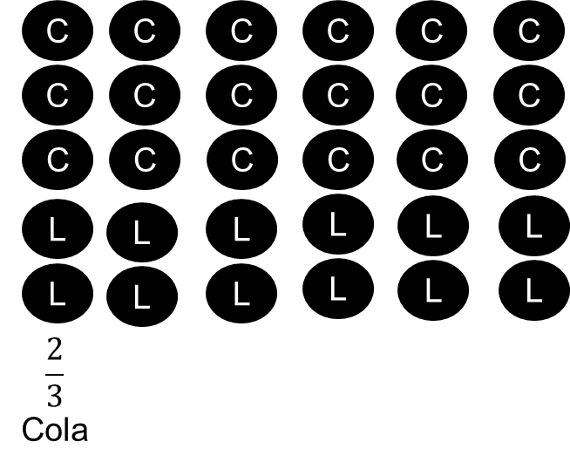
Encourages My Students to Use Representatives
How did this student solve?
How does the model show the answer?
Notes:
[Read the slide.]

Slide 43
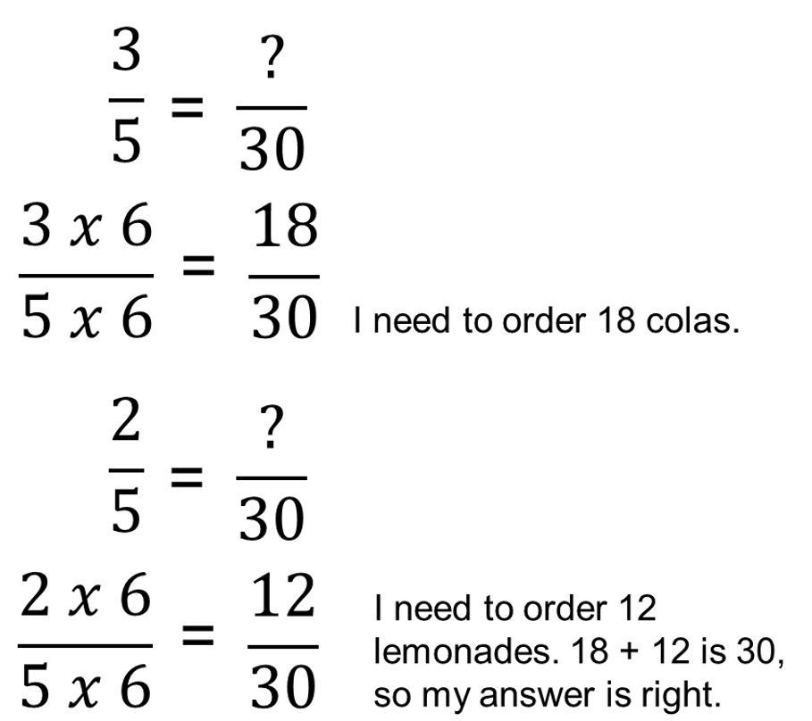
Encourages My Students to Use Representatives
How did the student solve?
How does the model show the answer?
Is this student’s answer more sophisticated than the previous student’s answer? Why or why not?
Notes:
[Facilitate discussion.]

Slide 44
Opportunities for Students to Communicate Their Reasoning
Students need practice of the actual problems, but they also need practice in communicating about mathematics.
Help students to do the following:
Work together to make sense of mathematics
Rely more on themselves to determine whether something is mathematically correct
Learn to reason mathematically
Evaluate their own processes and engage in productive peer interaction
Comprehend problems
Learn to conjecture, invent, and solve problems
Learn to connect mathematics, its ideas and its application
Persevere
Focus on the mathematics from activities
Notes:
A key aspect of engagement is student talk. When we think about discourse, most of us think about discussion or communication. Even the National Council of Teachers of Mathematics lists communication as an important process standard and defines ability to communicate as part of the role of a mathematician. Although middle school students may be social and like to talk, many students struggle to talk about mathematics! For many students, they have not been taught or coached in how to talk about mathematics. For example, many students can share the answer but struggle in how to communicate their thinking or process to solve. It is the role of the teacher to provide support to students to help teach them not only math skills but how to communicate their thinking and use mathematics precise language.

Slide 45
Opportunities for Students to Communicate Their Reasoning
Problem: If the cost of trading cards is two packs for $6, how much will it cost to buy 10 packages?
Write out a script of a conversation between teacher and student. Include higher level questions, as applicable. For example:
Teacher: I was walking around and saw a few different ways that students solved . . .
Notes:
[Have participants work in small groups. You can assign one person to the teacher and peers as the student. Think about the students who are in special education or are struggling. How might their communication differ than from communication of a peer who does not struggle?]

Slide 46
Allow for Different Strategies for Finding Solutions
Problem: Tell if the DIFFERENCE of each problem will be more than ½ or less than ½.
Choose one problem from above. Explain how you know the difference is more than ½ or less than ½.
First, consider the task. What prerequisite skills are needed to solve?
Second, anticipate the student responses. What will some of the students do to solve?
How does this task compare to other tasks students have completed?
Notes:
Another instructional strategy and evidence-based practice to increase student engagement is to identify tasks that allow for different strategies to find solutions. As teachers, we are sometimes guilty of showing one way, one procedure, rather than expanding on different ways that students may solve. Consider one-step equations to find a variable like 3 + x = 5. So often, teachers quickly teach the procedure of subtracting 3 from both sides of the equal sign, rather than ask students how they might find the missing value. When we remove possible solutions, we remove communication patterns and decrease overall discourse.
Consider this problem. What are different ways to solve?

Slide 47
Different Strategies and Multiple Entry Points: Example 1
Are the student’s answers correct?
What about the other comparisons?
How would you describe this student’s understanding of difference? Student understanding of benchmark fractions?
Does this work uncover any misconceptions?
How would you proceed? How could you bring in representations to help?
Notes:
Take a look at the student work. First, the student had to identify that the subtraction problem would be more or less than one half and then choose one problem from the above and describe how they know the difference is more than or less than one half. This student wrote, difference between three fourths and six twelfths is that 6/12 is greater than 3/4 because you can’t add it. Consider the questions on the slides. Is this student correct? Does the student fully understand the concepts?

Slide 48
Different Strategies and Multiple Entry Points: Example 2
Are the student’s answers correct?
What about the other comparisons?
How would you describe this student’s understanding of difference? Benchmark fractions?
Does this work uncover any misconceptions?
How would you proceed? How could you bring in representations to help?
Notes:
Consider this student. How do these answers differ in the student’s understanding? How would you proceed to help the student develop deeper understanding?

Slide 49
Allows for Different Strategies
Problem: Henry says that he knows that the difference of 7 $\frac{7}{8}$ $−$ 2 $\frac{1}{2}$ is greater than 5 without subtracting on a piece of paper. How might he know this? Henry also says that he knows the difference of 16 $\frac{2}{3}$ $−$ 5 $\frac{1}{6}$ is greater than 11 without subtracting on a piece of paper. How might he know this?
What is the purpose of this task?
What are different in ways in which students might solve?
How can we help students discuss their solutions?
Notes:
[Read slide. Have participants solve and then share different ways they solved. Facilitate discussion.]

Slide 50
Four Corners
Practice Increasing Engagement

Slide 51
Increasing Engagement Through Instruction
Planning instruction is vital, but so is identifying tasks that
lead to classroom discourse and discussion,
encourage the use of multiple representations, and
allow for multiple entry points and different strategies to solve.
Instruction needs to evolve from simply lecturing and providing one example to including tasks that may take more time but result in greater discussion and conceptual understanding!
Notes:
[Read slide.]

Slide 52
Four Corners: Step 1
Handout
Split into grade level:
6th grade
7th grade
8th grade
Special education and interventionist
Read the problems. Identify needed skills, including the prerequisite skills.
Complete the problem three different ways:
With math manipulatives or concrete representations
With a pictorial representation
Using abstract reasoning or representation
Notes:
[Read slide. Have problems by chart paper or use the handout following the activity debrief.]

Slide 53
Four Corners: Step 2
Rotate three times.
Each rotation:
Review how the problem was solved.
Review the additions from the previous group.
Make additions or edits as needed.
First rotation:
Identify at least one follow-up question per problem that leads to
increased student understanding and
increased student engagement.
Second rotation:
Identify a warm-up to connect the skill to prerequisite skills.
Third rotation:
Write an extension activity that connects the prerequisite skills to the skills completed.
Notes:
[Read slide.]

Slide 54
Debrief
How could you use this activity with students?
How could this activity lead to increased student engagement?
How could you complete a similar or shorter version of this activity as you plan?
How does this activity compare to your current planning?

Slide 55
Closing

Slide 56
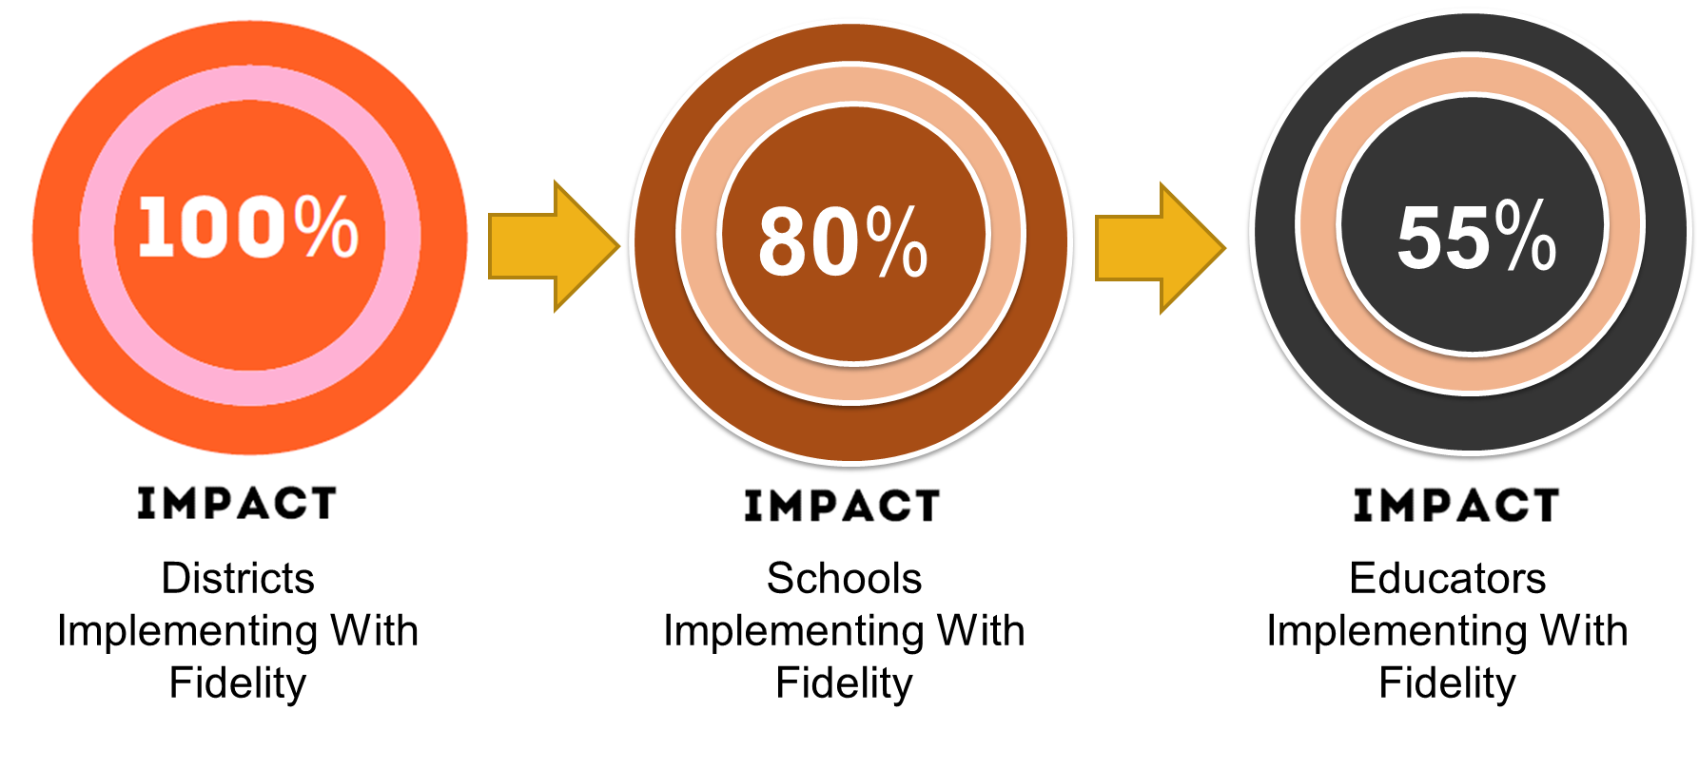
Effective Implementation and Engagement Take Time: Effects After 2 Years
*Data collected from Georgia and Wyoming educators 2017–20
Notes:
It is okay if you do not feel like you are doing it right immediately—change takes time! Start small; first focus on one or two evidence-based practices as a means to increase engagement then add in specific scaffolds and high-leverage practices. It is important to create or use a fidelity tool like the EQUIP (Marshall, 2019) to measure the specific evidence-based practices and/or high-leverage practices within mathematics core classrooms, as well as within special education and intervention classrooms.

Slide 57
Try, Try, and Try Again!
Teams must engage in ongoing continuous improvement activities to refine implementation over time.
If you are not seeing impact, you are not there yet.
www.promotingprogress.org
Notes:
[Read slide.]

Slide 58
In Closing
It is important to think about, include, and consider mathematics evidence-based practices in planning and teaching. Also, remember that, when students are not engaged, it is often a result of instruction!
Changing our own adult behaviors can be hard! As part of planning, take time to build your own knowledge and skill to meet individual student needs, instead of being reactive during instruction!
Collect data to drive instruction on skills but also on attention, involvement, and engagement of students. Low engagement does not mean low motivation, but rather low engagement could be quality of delivery of instruction or program specificity to meeting student needs.
https://intensiveintervention.org/resource/five-elements-fidelity
Notes:
[Read slide.]

Slide 59
Resources and References

Slide 60
Resources
Mathematics tasks and word problems:
Coherence Map
NAEP Questions Tool
Smarter Balanced Assessment Consortium Sample Items
Virtual mathematics manipulatives:
Various Mathematics Manipulatives From Didax (all free)
Fraction Manipulatives From Toy Theater
National Library of Virtual Manipulatives
Notes:
Many questions that were included are available for free within the coherence map, NAEP questions tool, and Smarter Balanced Assessment Consortium sample question bank.

Slide 61
References
Council for Exceptional Children & CEEDAR Center. (2015). High-leverage practices in special education. CEC: VA.
Fuchs, L. S., Newman-Gonchar, R., Schumacher, R., Dougherty, B., Bucka, N., Karp, K. S., Woodward, J., Clarke, B., Jordan, N. C., Gersten, R., Jayanthi, M., Keating, B., & Morgan, S. (2021). Assisting students struggling with mathematics: Intervention in the elementary grades (WWC 2021006). National Center for Education Evaluation and Regional Assistance, Institute of Education Sciences, U.S. Department of Education. http://whatworks.ed.gov/
Herbel-Eisenmann, B. & Otten, S. (2011). Mapping mathematics in classroom discourse. Journal for Research in Mathematics Education, 52(5), 451-485.
Hufferd-Ackles, K., Fuson, K. C., & Sherin, M. G. (2004). Describing levels and components of a math-talk learning community. Journal for Research in Mathematics Education, 35(2), 81–116.
National Council of Teachers of Mathematics. (2014). Principles to actions. Ensuring mathematical success for all.
Schielack, J. (2010). Focus in grade 6. Teaching with curriculum focal points. National Council of Teachers of Mathematics: VA.
Schnitzler, K., Holzberger, D. & Seidel, T. (2020). All better than being disengaged: Student engagement patterns and their relations to academic self-concept and achievement. European Journal of Psychology of Education, 36, 627-652.
Simpson, A., Mokalled, S., Ellenburg, LA., & Che, M. (2015). A tool for rethinking teachers’ questioning. Mathematics Teaching in the Middle School, 20(5), 294-302.

Slide 62
Disclaimer
This content was produced under U.S. Department of Education, Office of Special Education Programs, Award No. H326M17002. Christina Diamond serves as the project officer. The views expressed herein do not necessarily represent the positions or polices of the U.S. Department of Education. No official endorsement by the U.S. Department of Education of any product, commodity, service, or enterprise mentioned in this website is intended or should be inferred.

